Slide 1


Zimbabwe Seasonal Monitor
FEBRUARY 2026
ZIMBABWE METEOROLOGICAL SERVICES DEPARTMENT
http://www.msd.org.zw/

Slide 2
1. Highlights
Crop area& production
Key Highlights
The 2025/2026 season has been characterized by strong intra-seasonal variability, with a shift from above-normal rainfall in January to a prolonged dry spell from late January through February, followed by a partial and uneven recovery in March.
January rainfall was widespread and above average, supporting early crop development and leading to significant water resource recharge, with major dams reaching near or full capacity. However, localized flooding and waterlogging affected some areas.
The February dry spell, combined with high temperatures, resulted in rapid soil moisture depletion and widespread crop stress, particularly in rainfed systems.
Rainfall in March resumed but remained spatially inconsistent, with below-average conditions persisting in central, eastern, and northern areas, limiting recovery from February moisture deficits.
The uneven temporal distribution of rainfall, rather than total seasonal accumulation, is the main driver of risk this season, as critical crop growth stages coincided with moisture stress.
While water availability for irrigation remains favourable, the agricultural outlook is mixed, with potential yield reductions in areas most affected by the February dry spell and poor March rainfall performance.

Slide 3

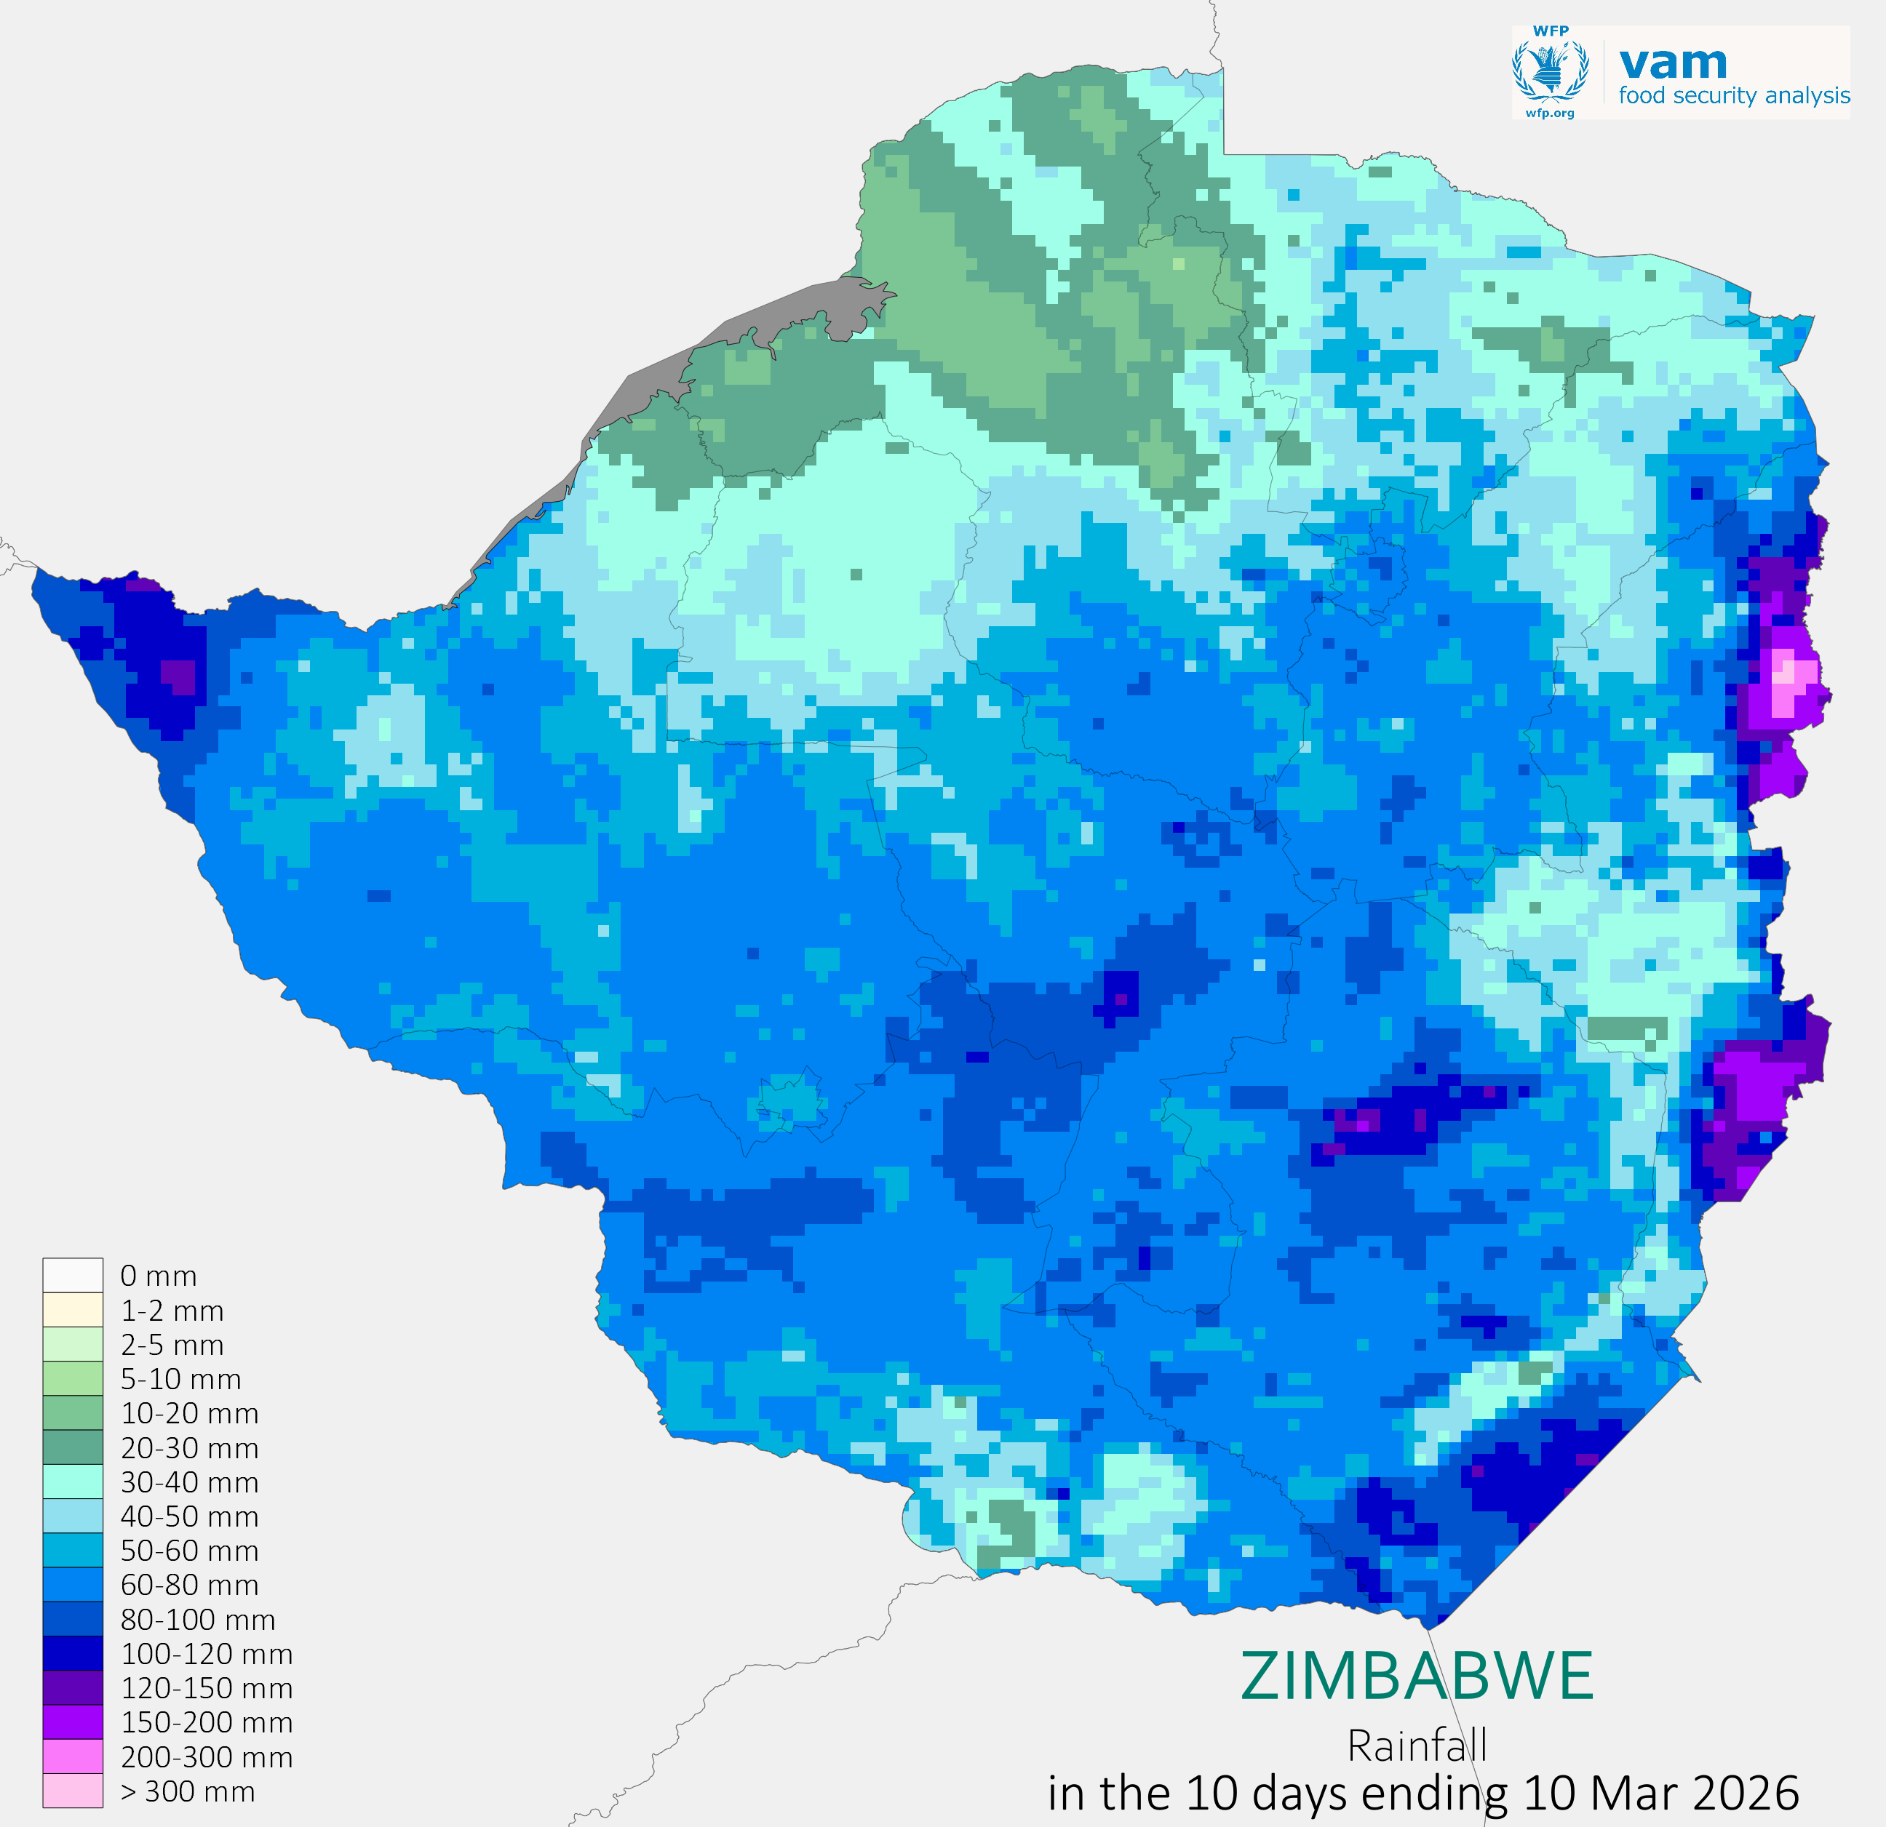
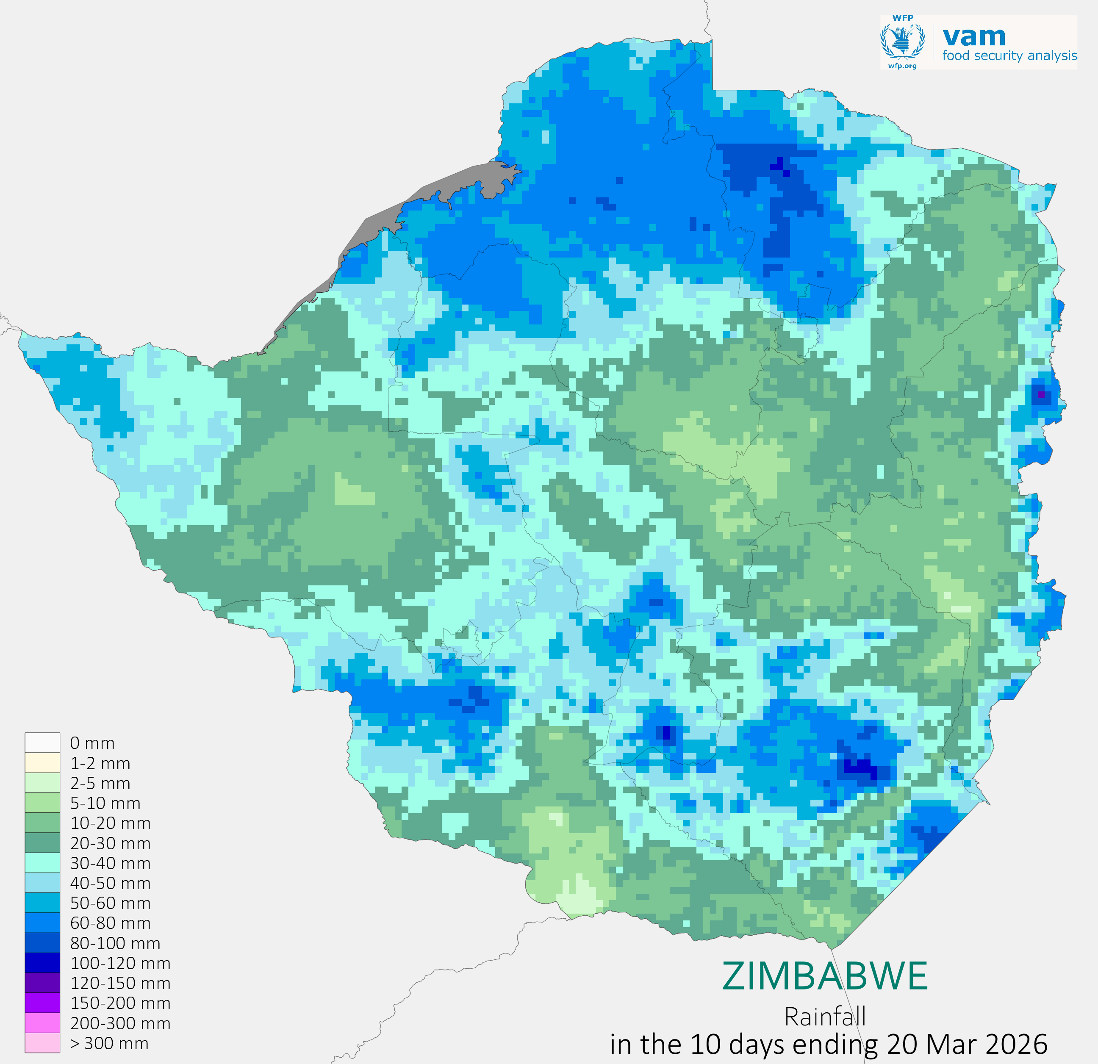
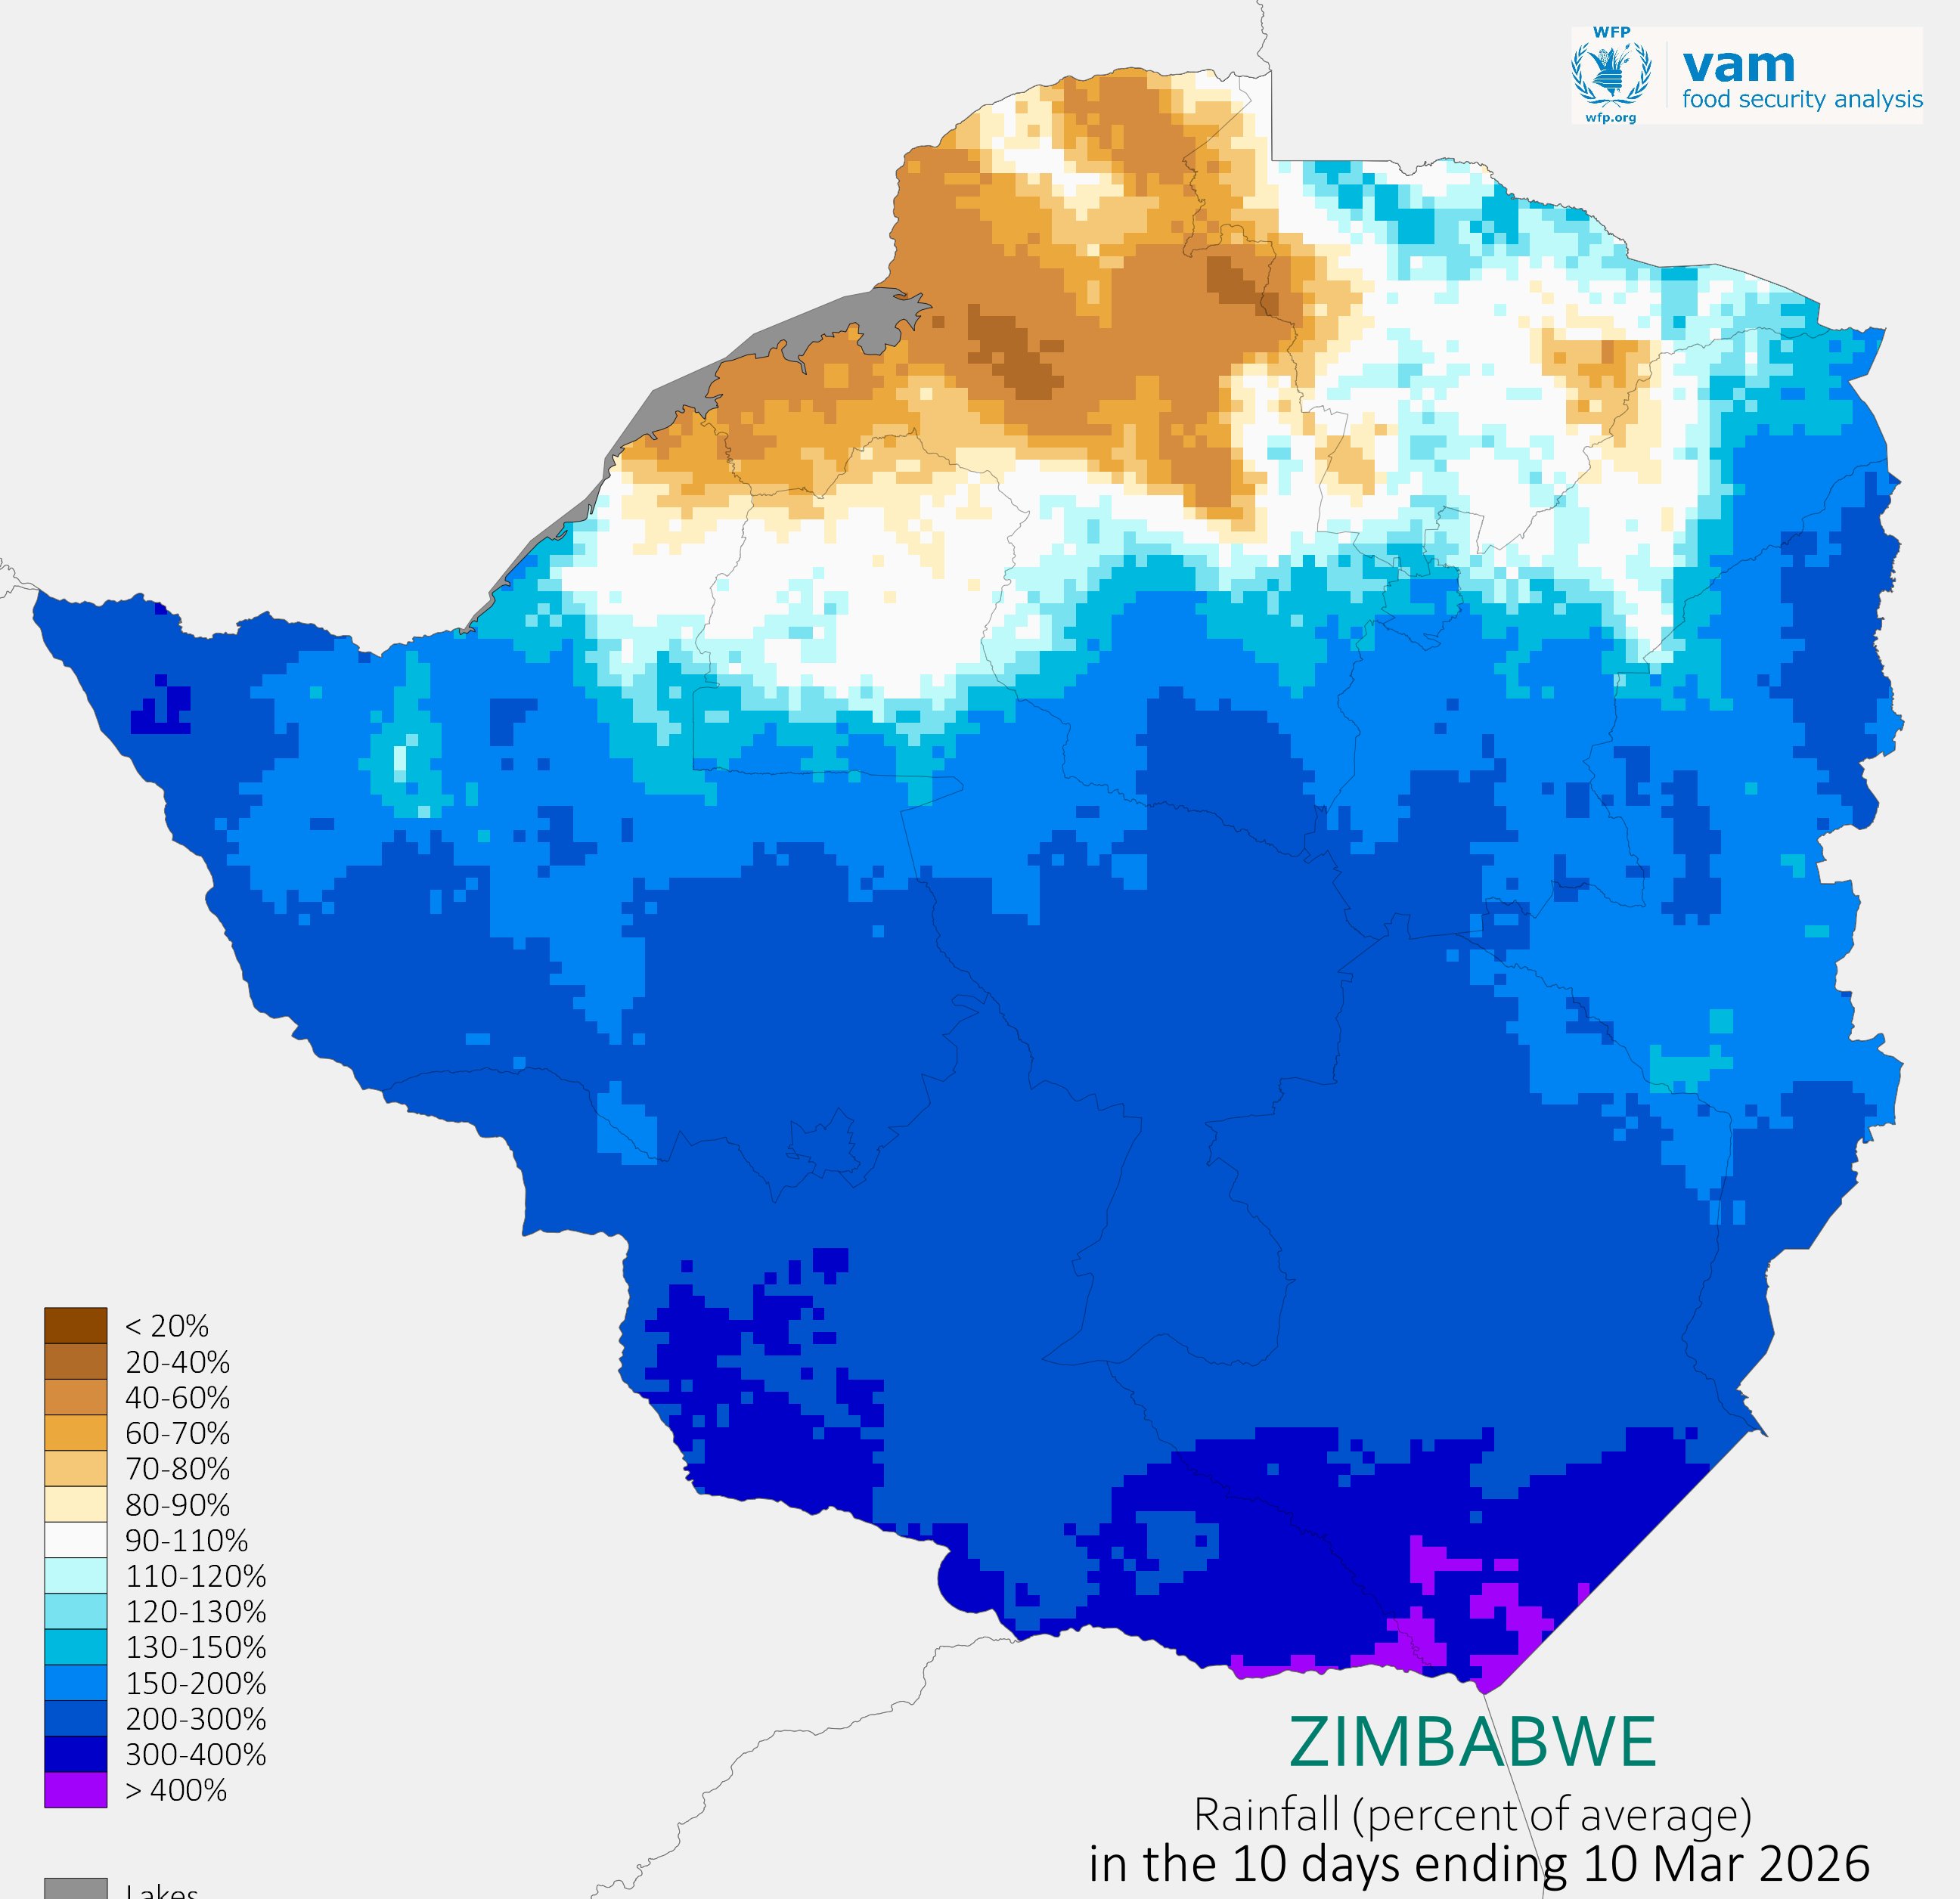
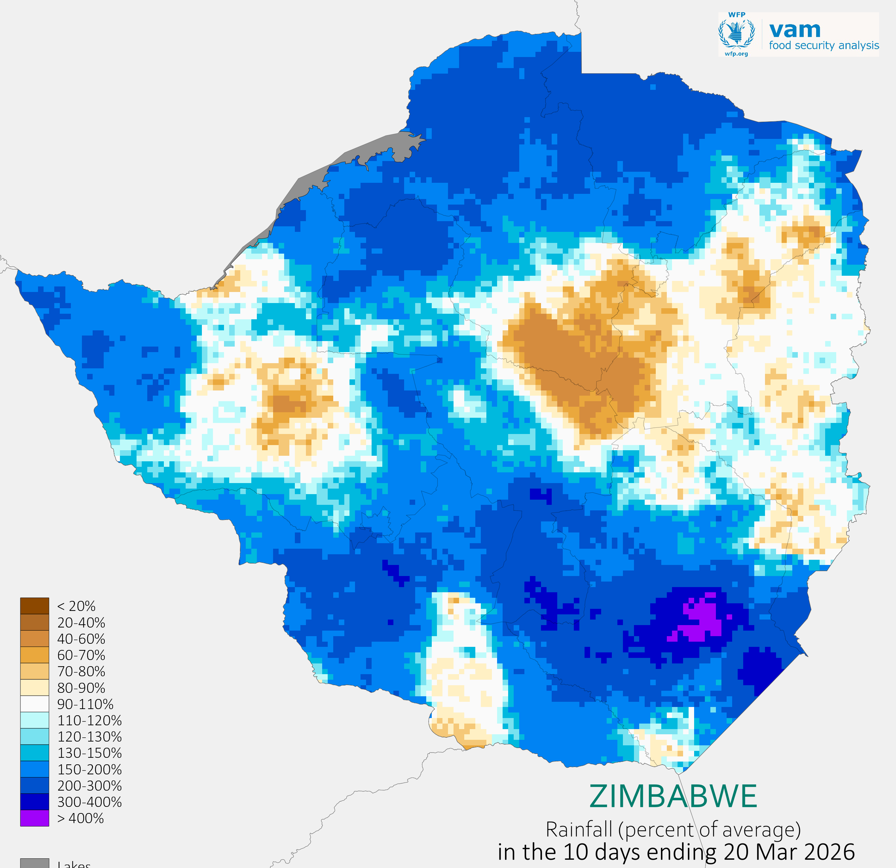
2. Rainfall: Early March
January brought widespread above-normal rainfall, resulting in strong water availability but also localized flooding. This was followed by a prolonged dry spell from late January through February, which led to significant moisture stress and might have affected crop development across much of the country.
In early March, rainfall remained below average in northern areas, prolonging moisture deficits following the February dry spell. Conditions improved in parts of the western and southern regions by mid-March; however, dry pockets persisted across central and eastern areas. Overall, March rainfall has resulted in partial and uneven recovery, with several areas failing to fully recover from earlier moisture deficits.
Fig 1(a) Rainfall amounts in mm, in the 10 days ending 10 March 2026 (left) and 20 March 2026 (right)
Fig 1(b).Rainfall in the 10 days ending 10 March 2026(left) 20 March 2026(right), as percent of average. Browns = drier than average, blues = wetter than average
Notes:
Recap the season here, irregularity of the eason, irregular season gdry=wet alternation
colored text. Highlight the impact of drier than usual conditions on agriculture and livestock in most countries.

Slide 4
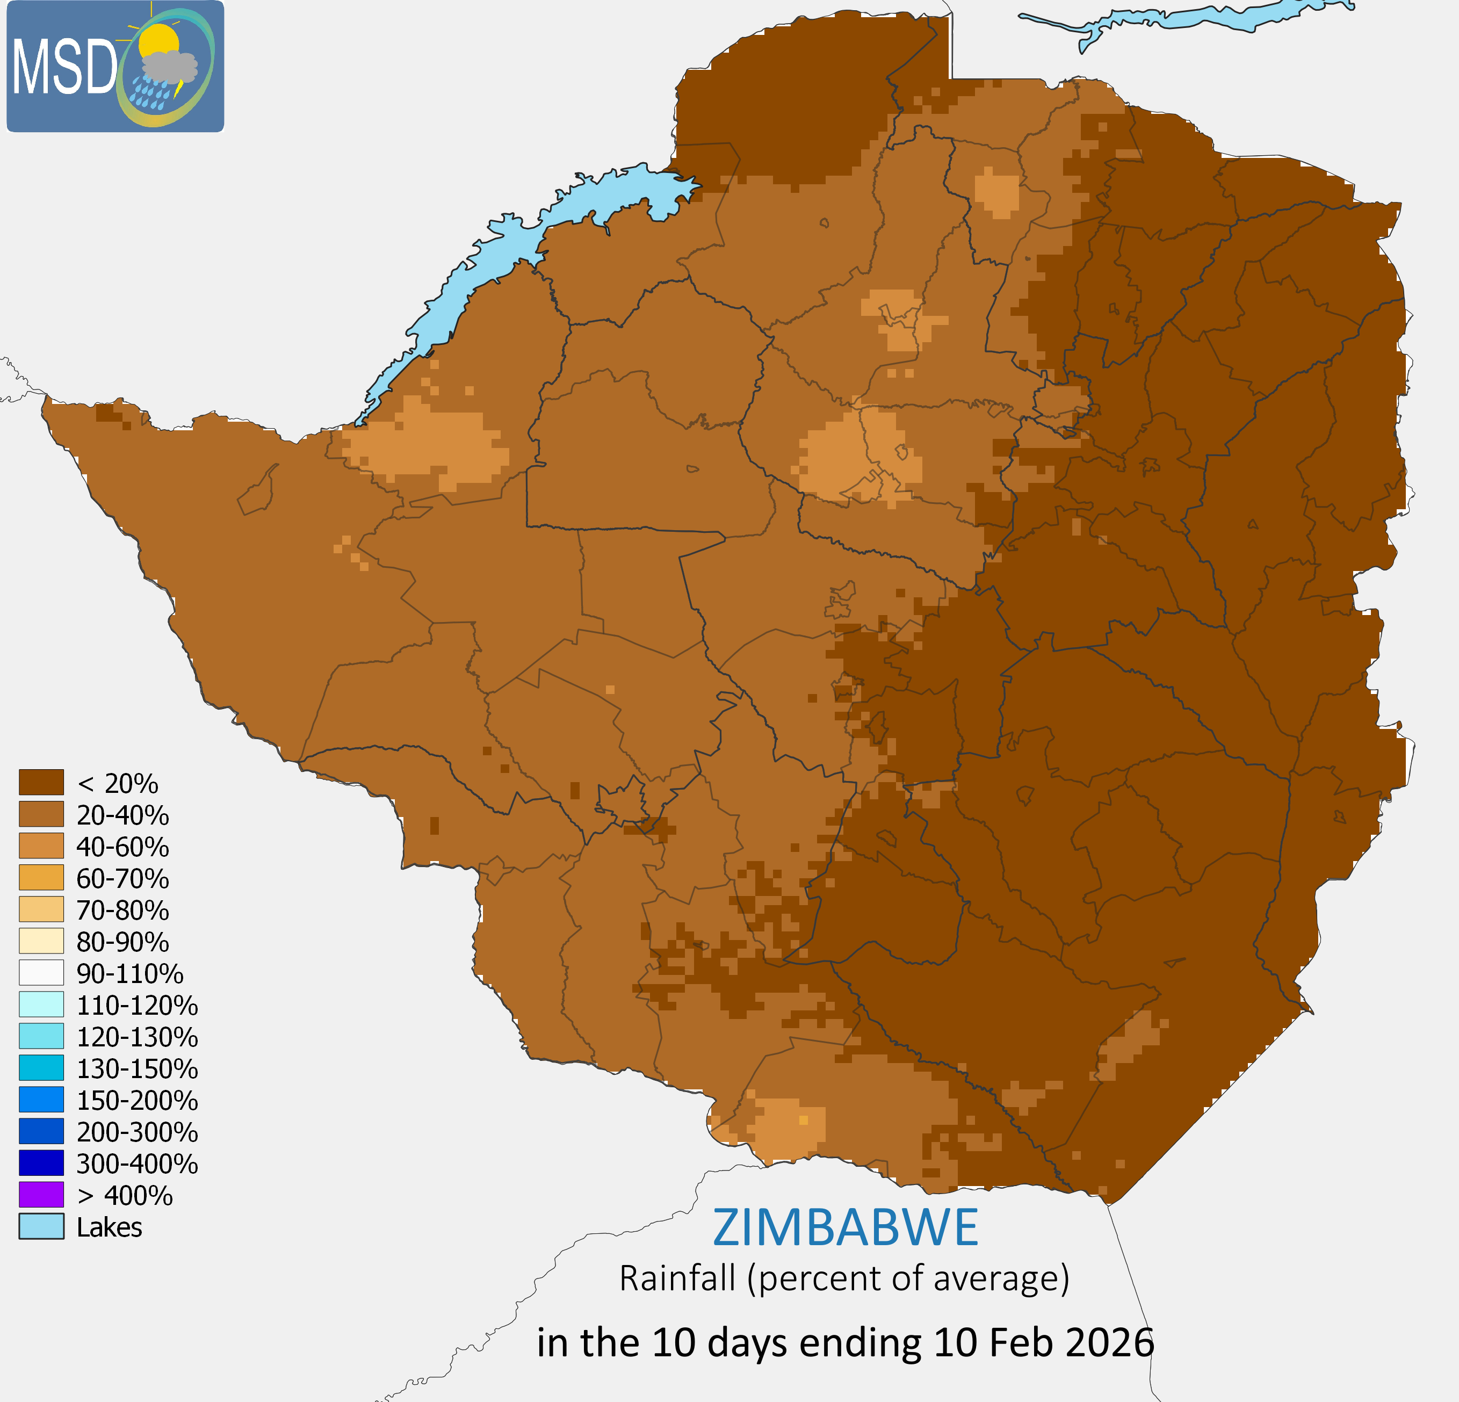
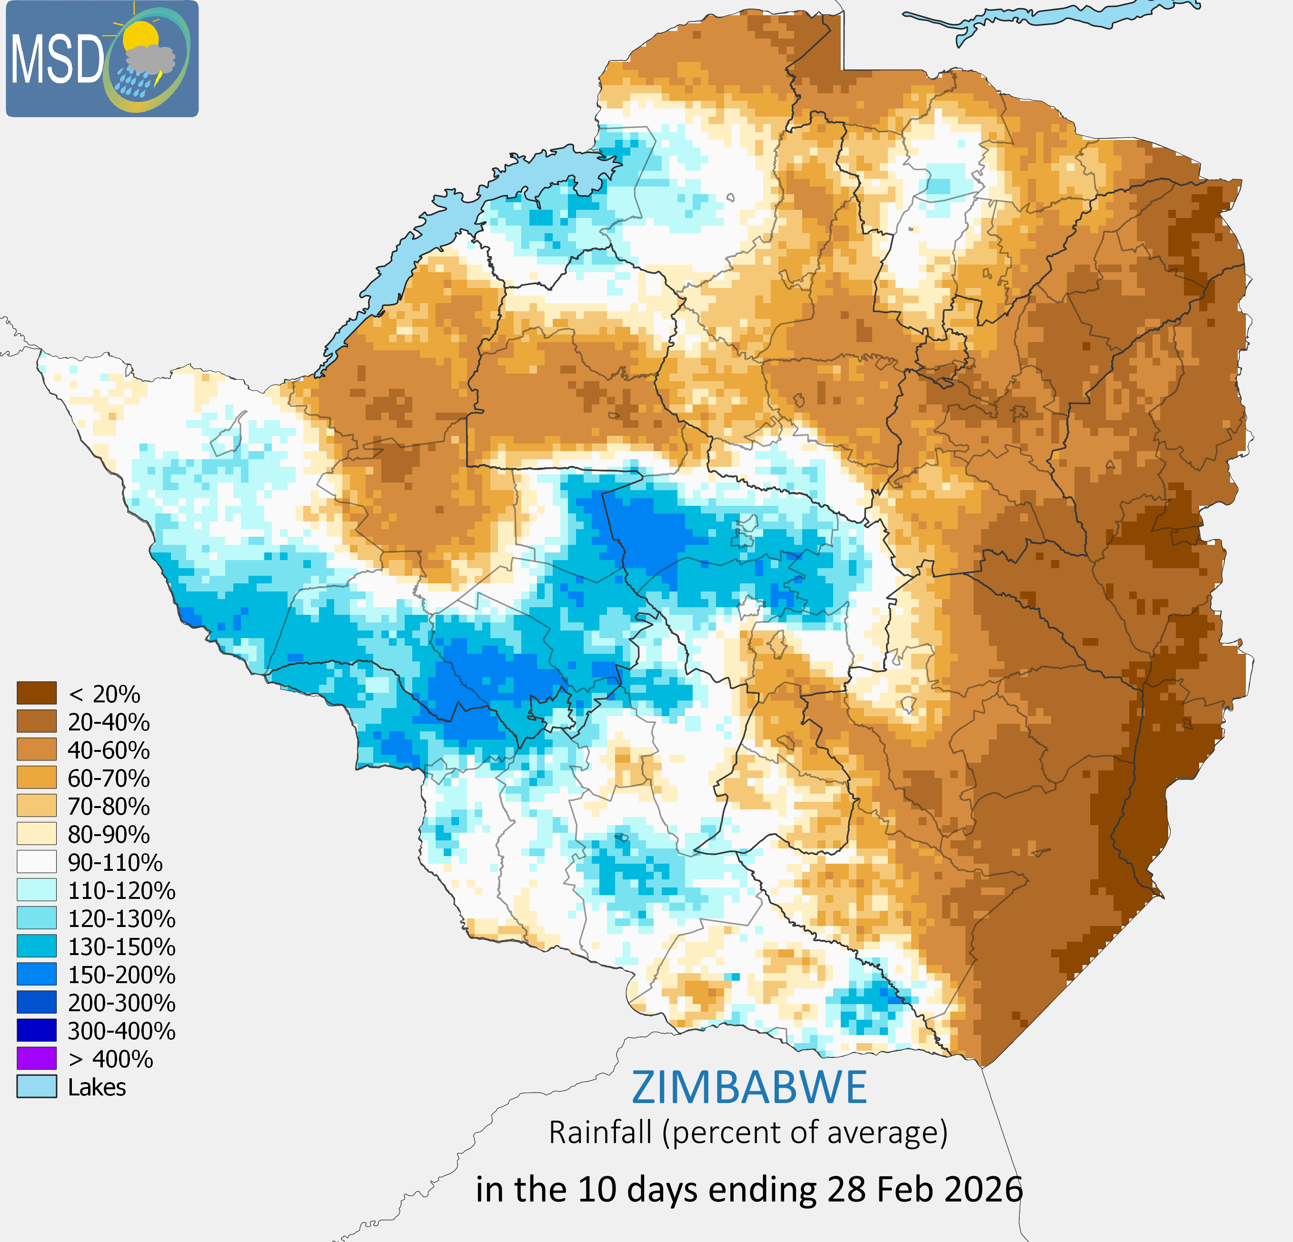
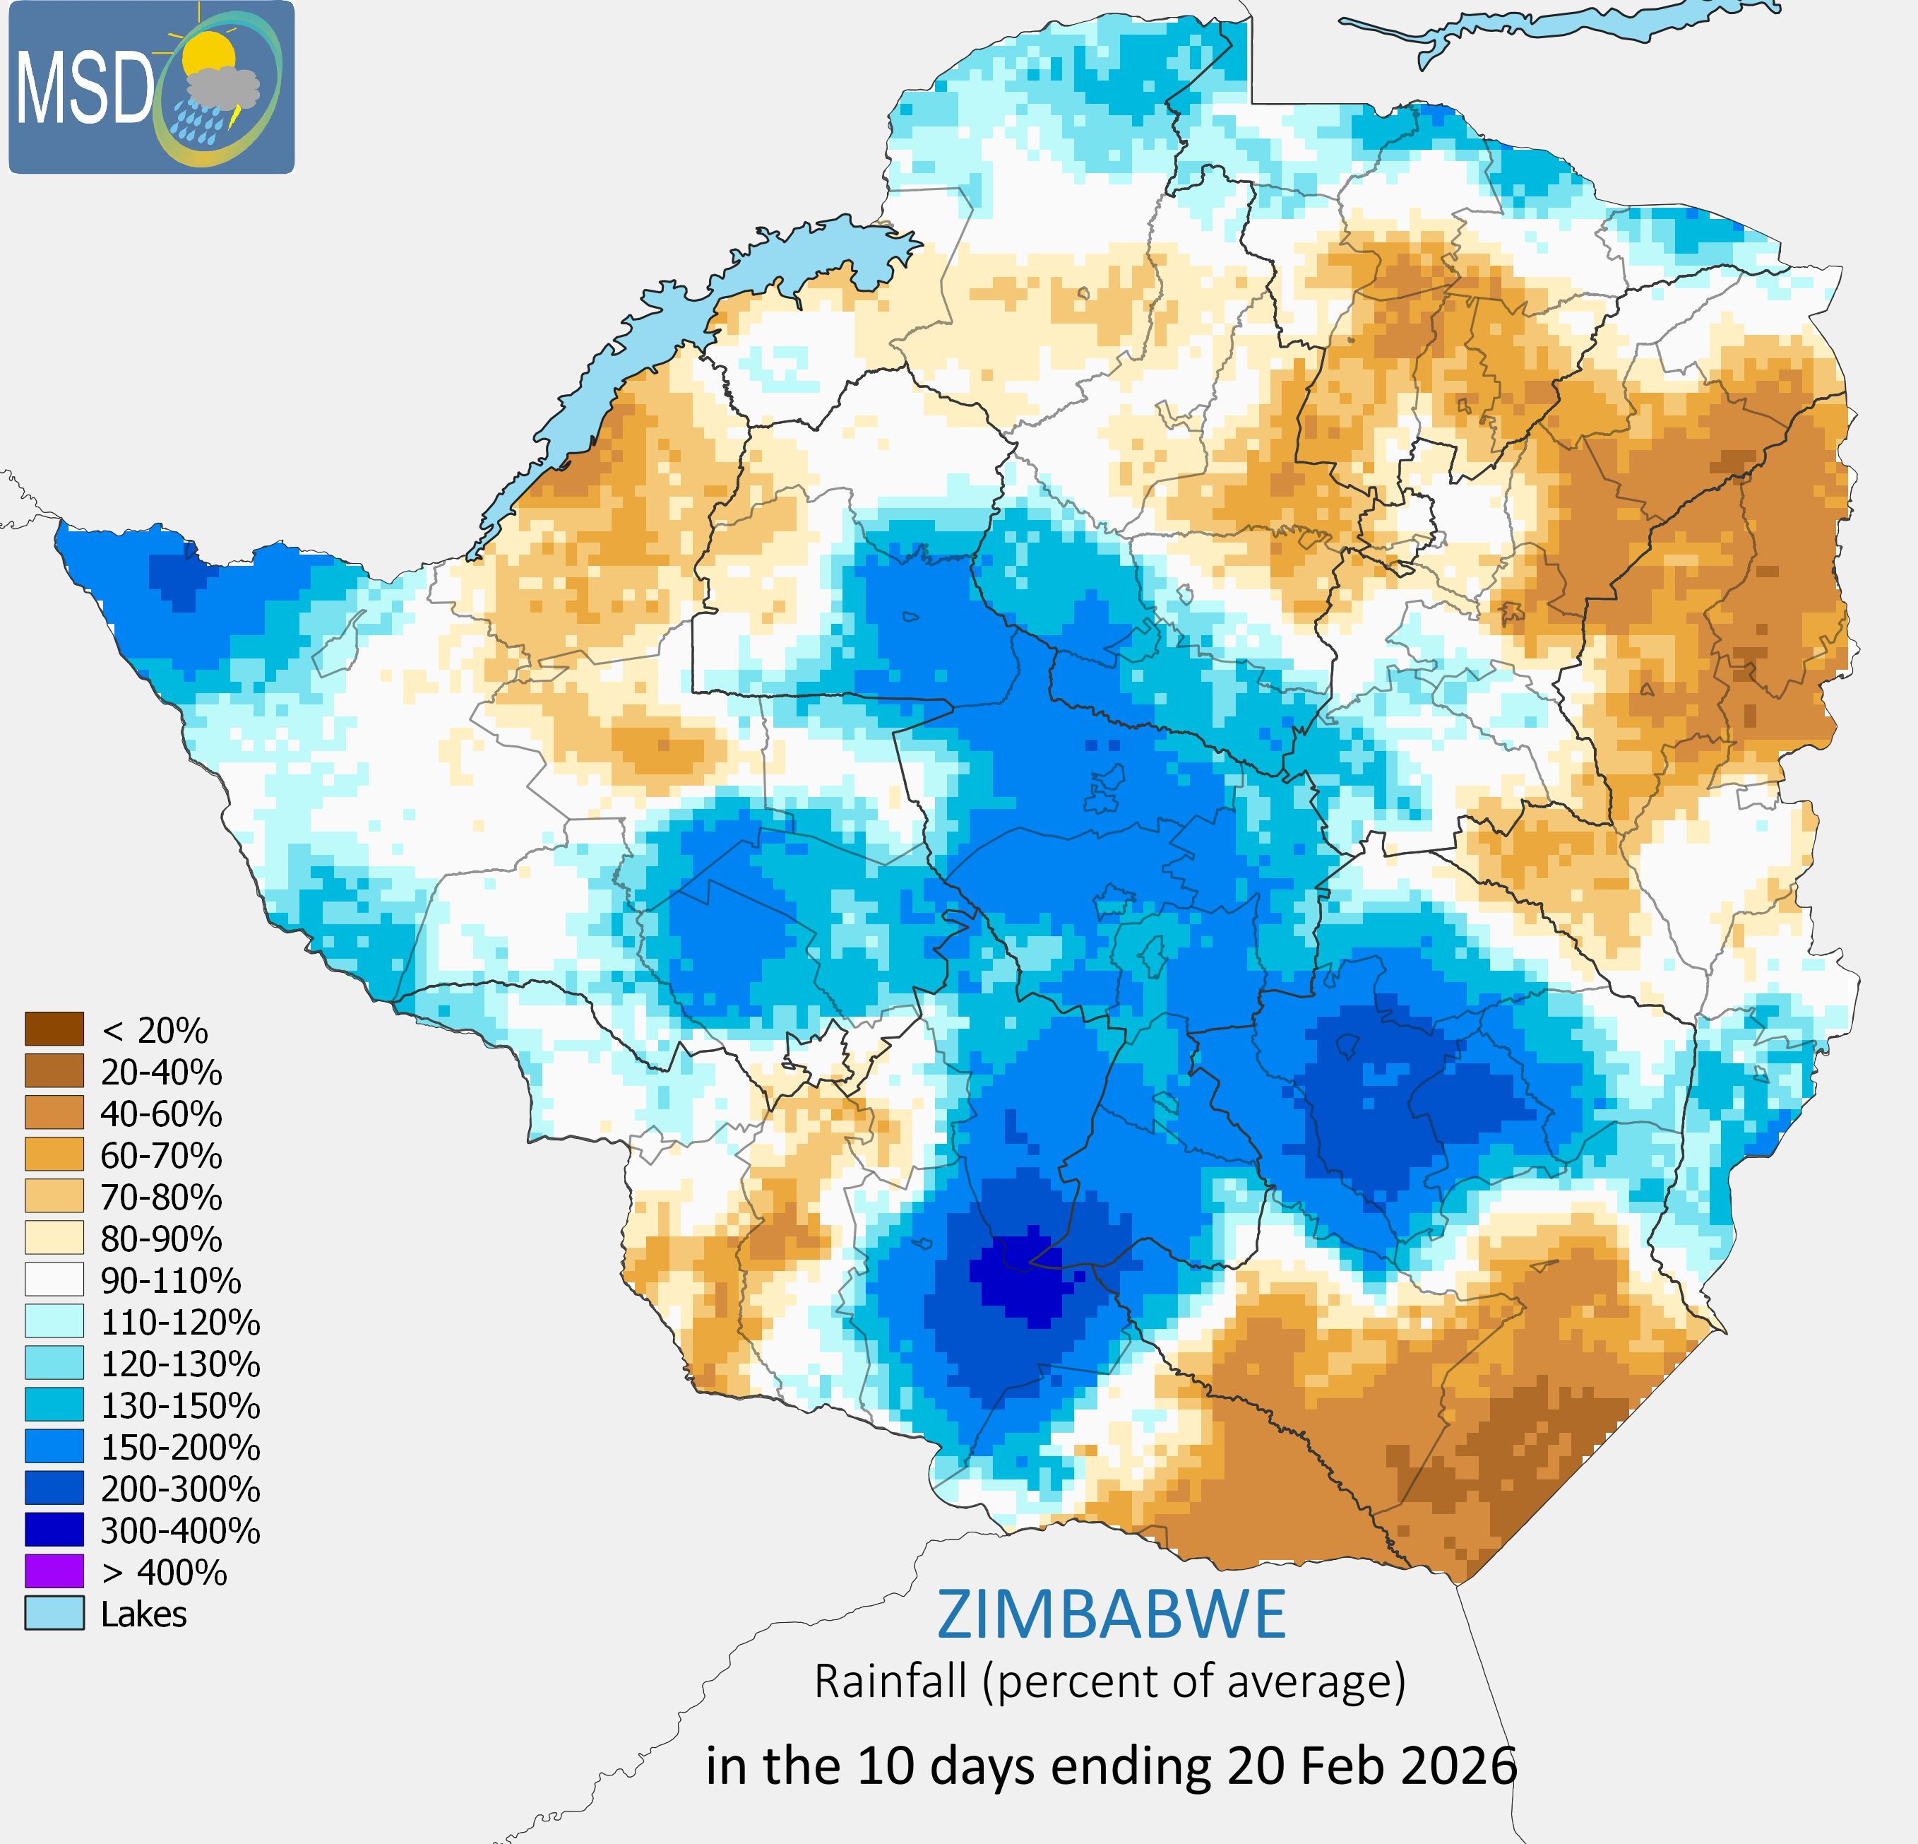
3. Rainfall: February
(a)
(b)
(c)
Fig 2(a) Rainfall in the ending 10 days ending 10 February 2026, Rainfall in the 10 days ending 20 (b) , Rainfall in the 10 days ending 28(c) as percent of average. Browns = drier than average, blues = wetter than average
February was dominated by a prolonged dry spell that began in late January and persisted through most of the month. In the first dekad, below-average rainfall was widespread across the country. Conditions remained largely suppressed during the second and third dekads, with rainfall deficits observed across most regions and only localized areas receiving above-average precipitation
As shown in Fig2(b) & Fig 2(c), above-normal rainfall (blue in Fig 2b) was confined to localized areas, including Matabeleland North, Matabeleland South and Midlands) while a few regions recorded near-normal totals. The subdued rainfall activity is attributed to two dominant synoptic systems: the dry, subsident effects of Tropical Cyclone Gezani (active from 4 to 20 February) and persistent high-pressure systems, which inhibited convective cloud development.
Notes:
Recap the season here, irregularity of the eason, irregular season gdry=wet alternation
colored text. Highlight the impact of drier than usual conditions on agriculture and livestock in most countries.

Slide 5
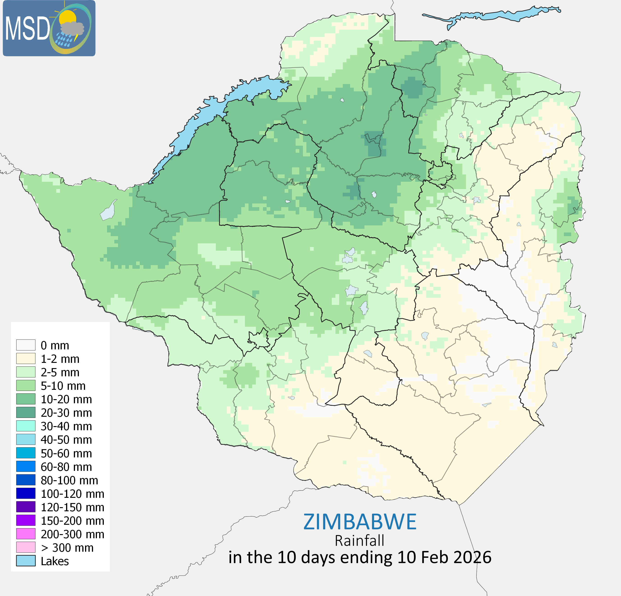
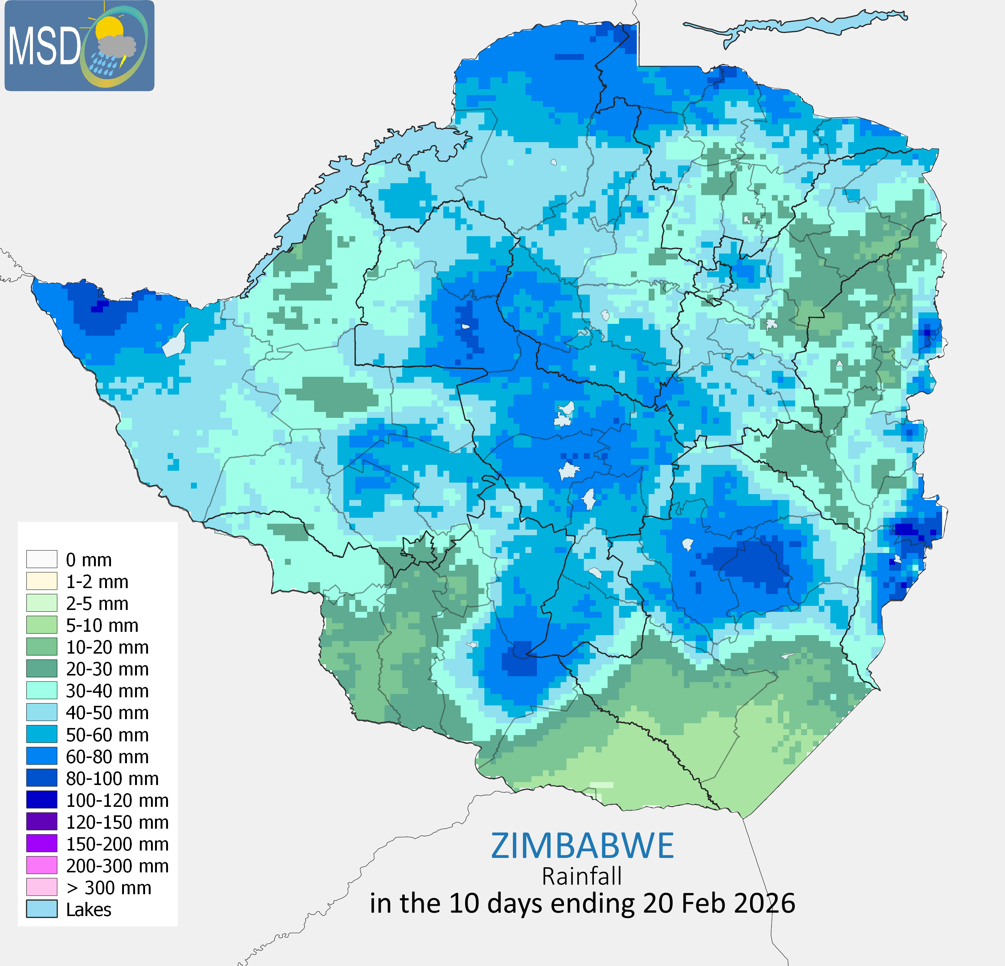
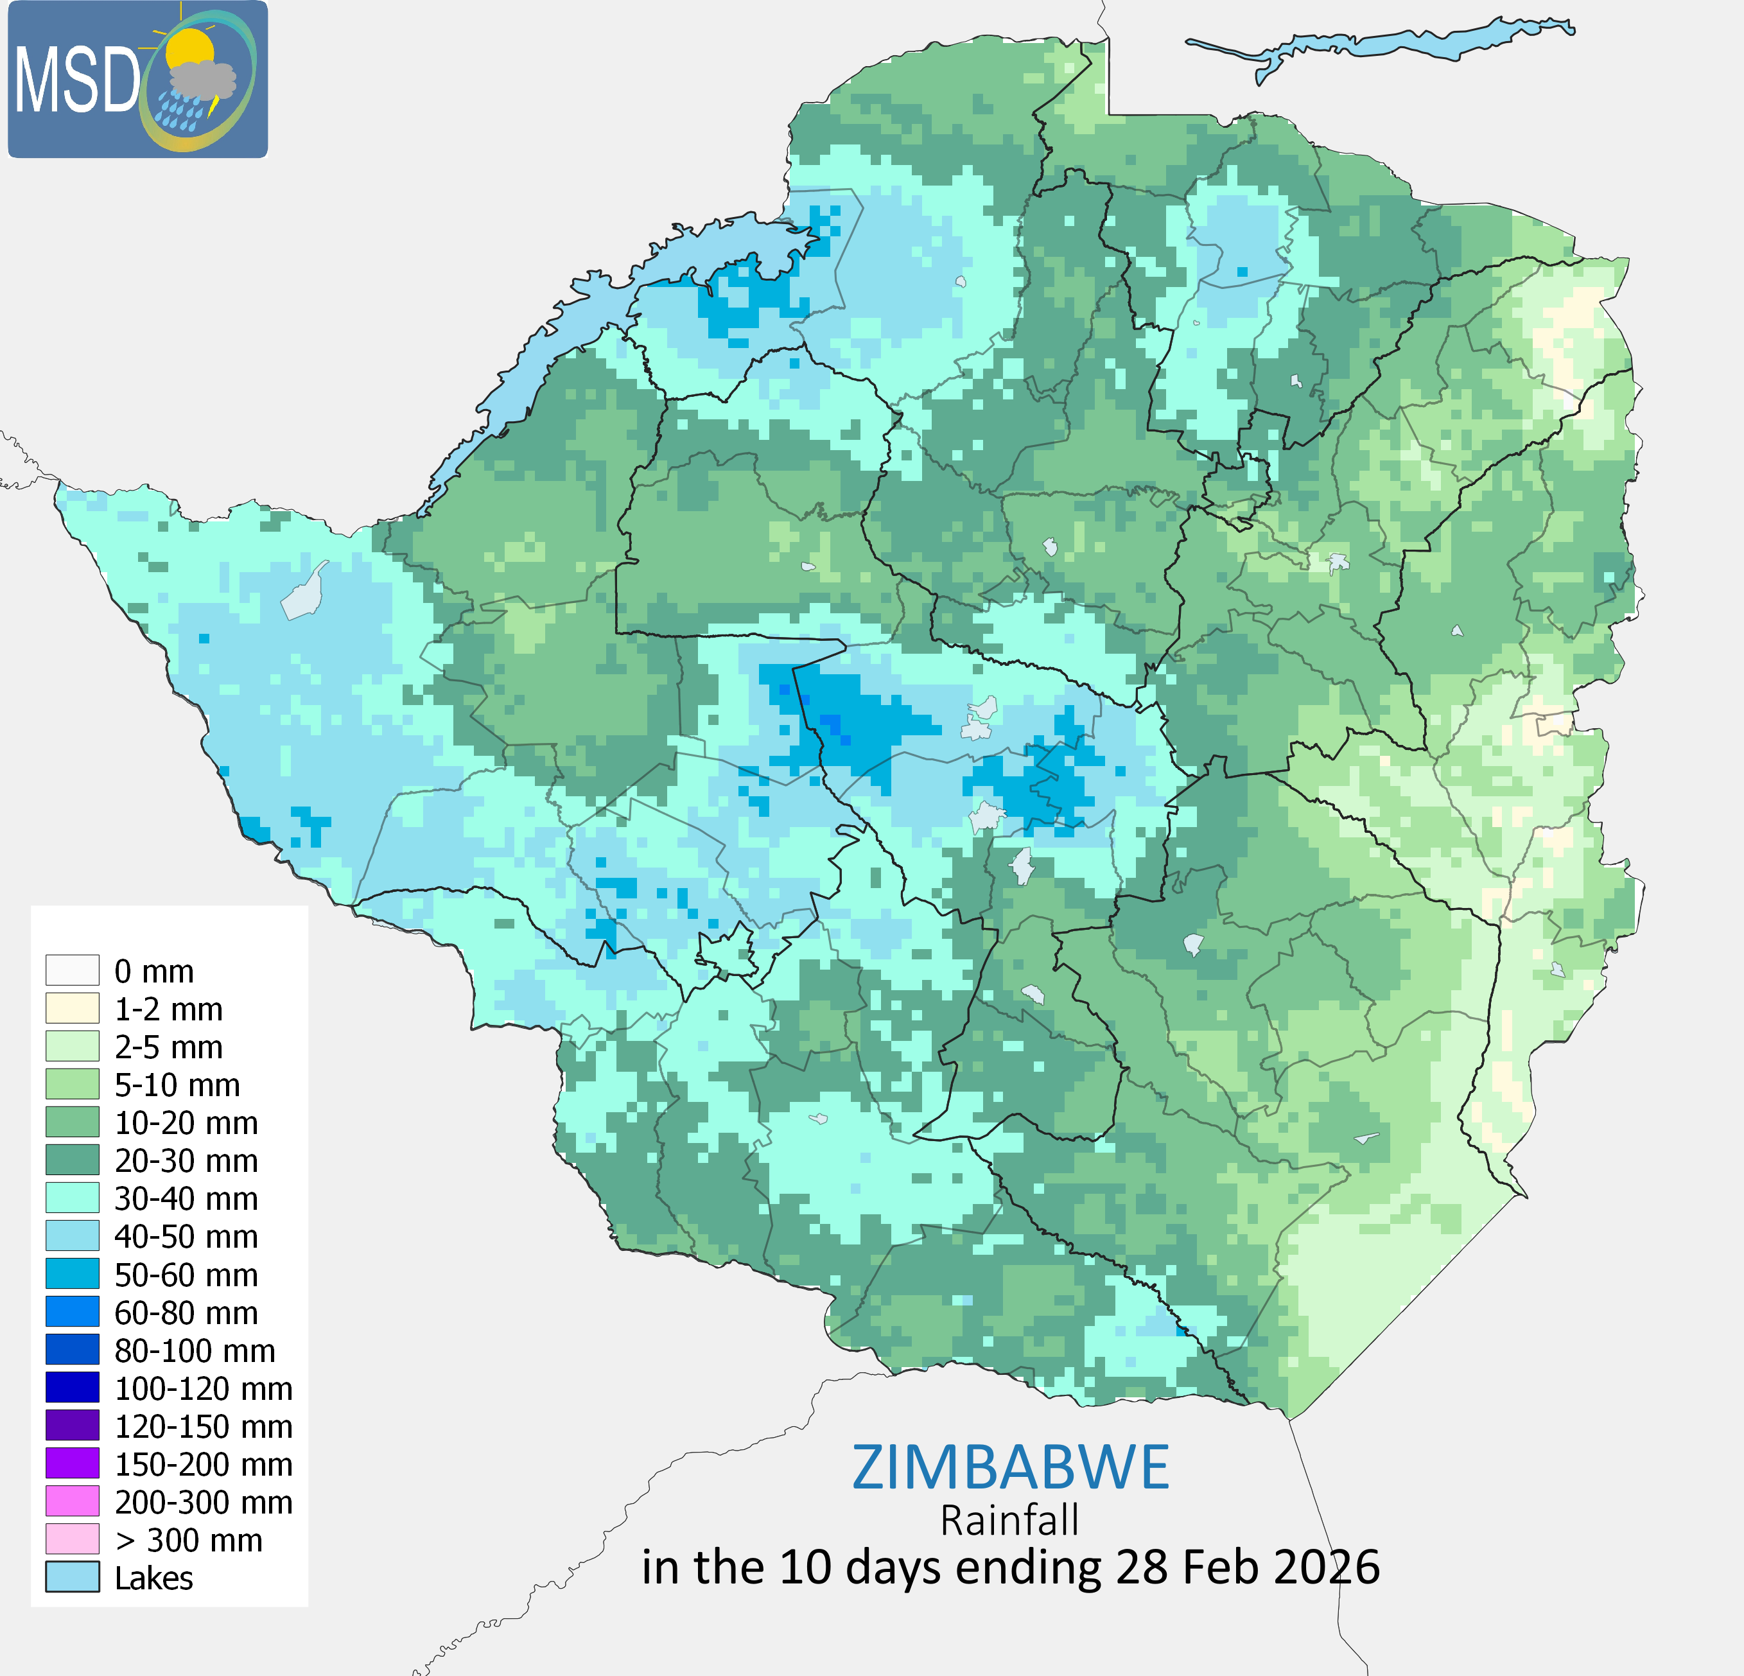
4. Rainfall: February
a
(b)
(c)
(a)
(f) Rainfall amounts in mm in February 2026
Fig 3(a) Rainfall amounts in mm 10 days ending 10 February 2026, Rainfall in the 10 days ending 20 (b), Rainfall in the 10 days ending 28(c) as percent of average. Browns = drier than average, blues = wetter than average
Climatic conditions during February 2026 were characterized by persistent clear skies and high temperatures, a dry spell that had commenced on 25 January.
Although isolated thunderstorms were observed, they contributed minimal precipitation. Monthly rainfall accumulations were generally low, with most areas receiving below 150mm.
Notes:
Recap the season here, irregularity of the eason, irregular season gdry=wet alternation
colored text. Highlight the impact of drier than usual conditions on agriculture and livestock in most countries.

Slide 6
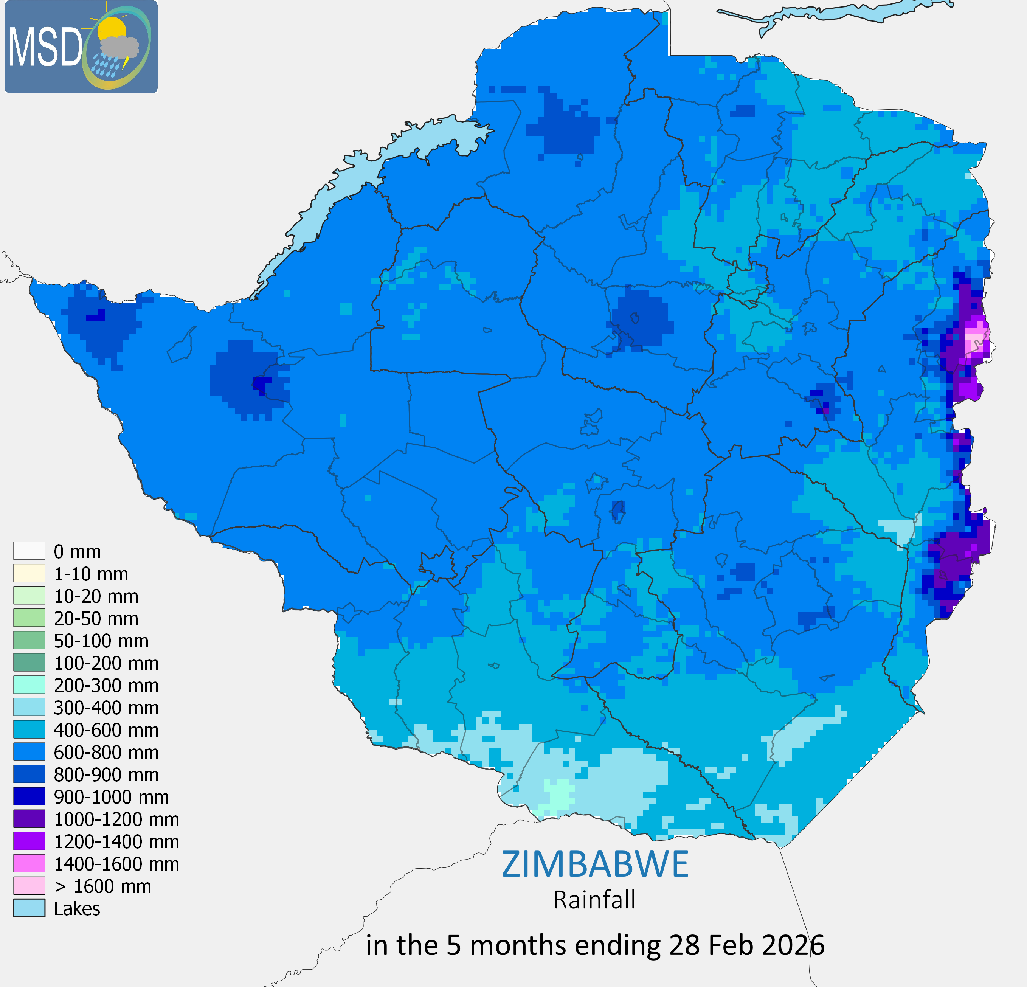
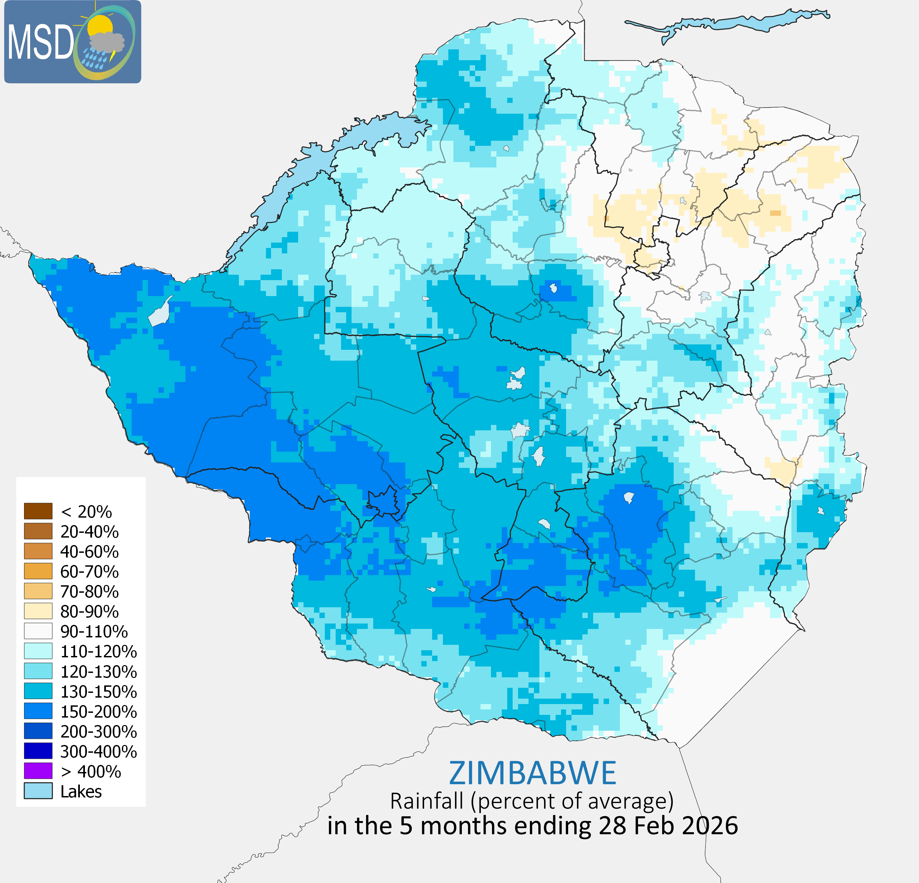
5. Season so far:
Fig 4(a) Rainfall amounts in mm, in the 5 months ending 28 Feb 2026
Fig 4(b) Rainfall as percentage of average in the 5 months ending 28 Feb 2026
For the period from October 2025 to February 2026, cumulative rainfall has been near to above average across most of the country. However, despite these favourable totals, the uneven temporal distribution of rainfall has had a significant impact on agricultural conditions.
The prolonged dry spell from late January through February disrupted crop development in several areas, particularly where moisture stress coincided with sensitive growth stages. At the same time, the season has resulted in substantial water resource recharge, with most major reservoirs reaching full capacity, supporting irrigation potential for the upcoming winter season as reported by the Zimbabwe National Water Authority.
Notes:
Recap the season here, irregularity of the eason, irregular season gdry=wet alternation
colored text. Highlight the impact of drier than usual conditions on agriculture and livestock in most countries.

Slide 7
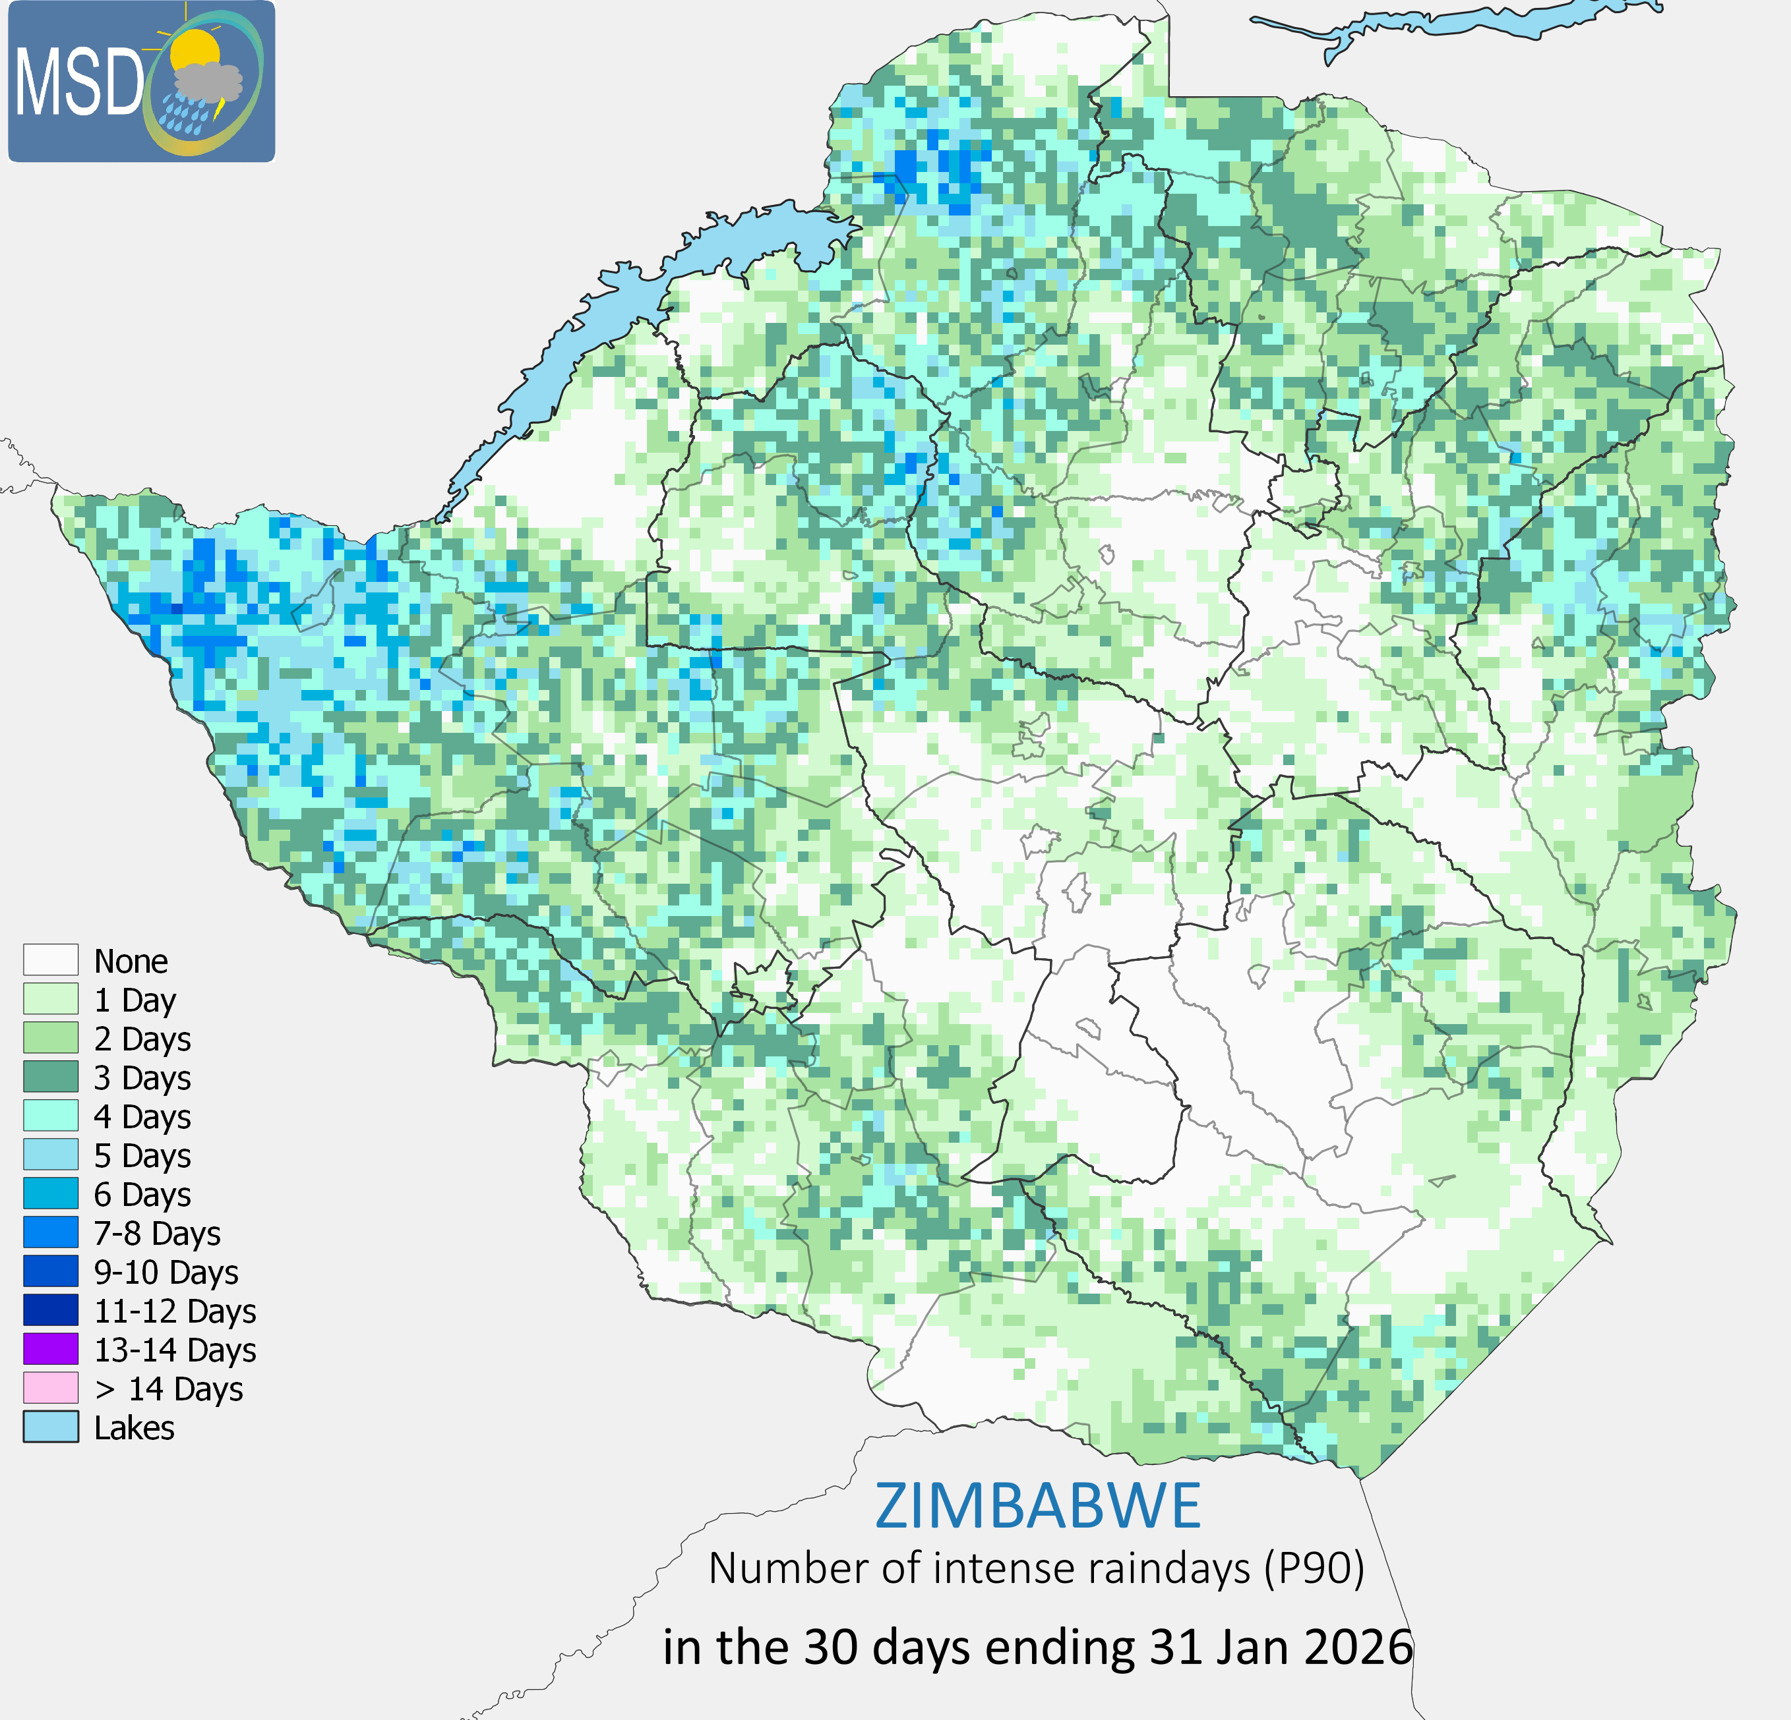
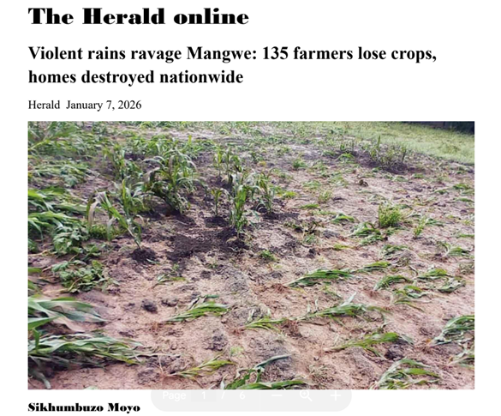
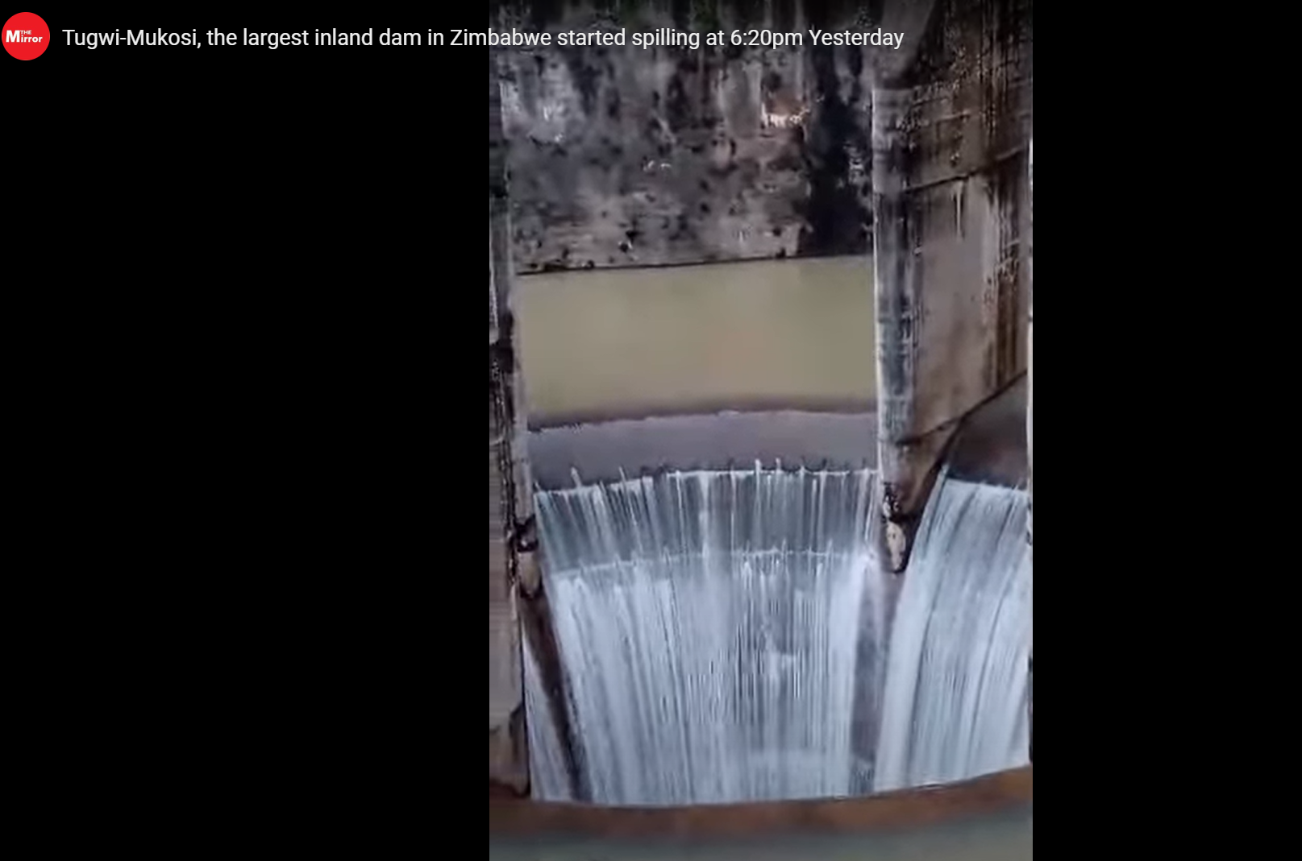
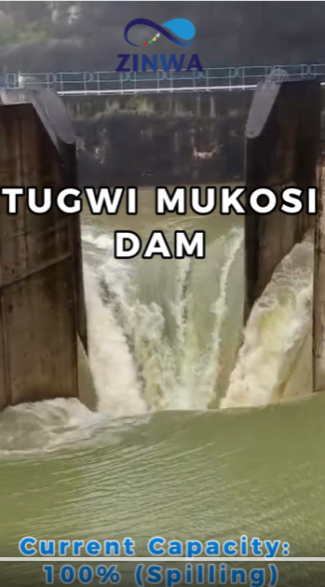
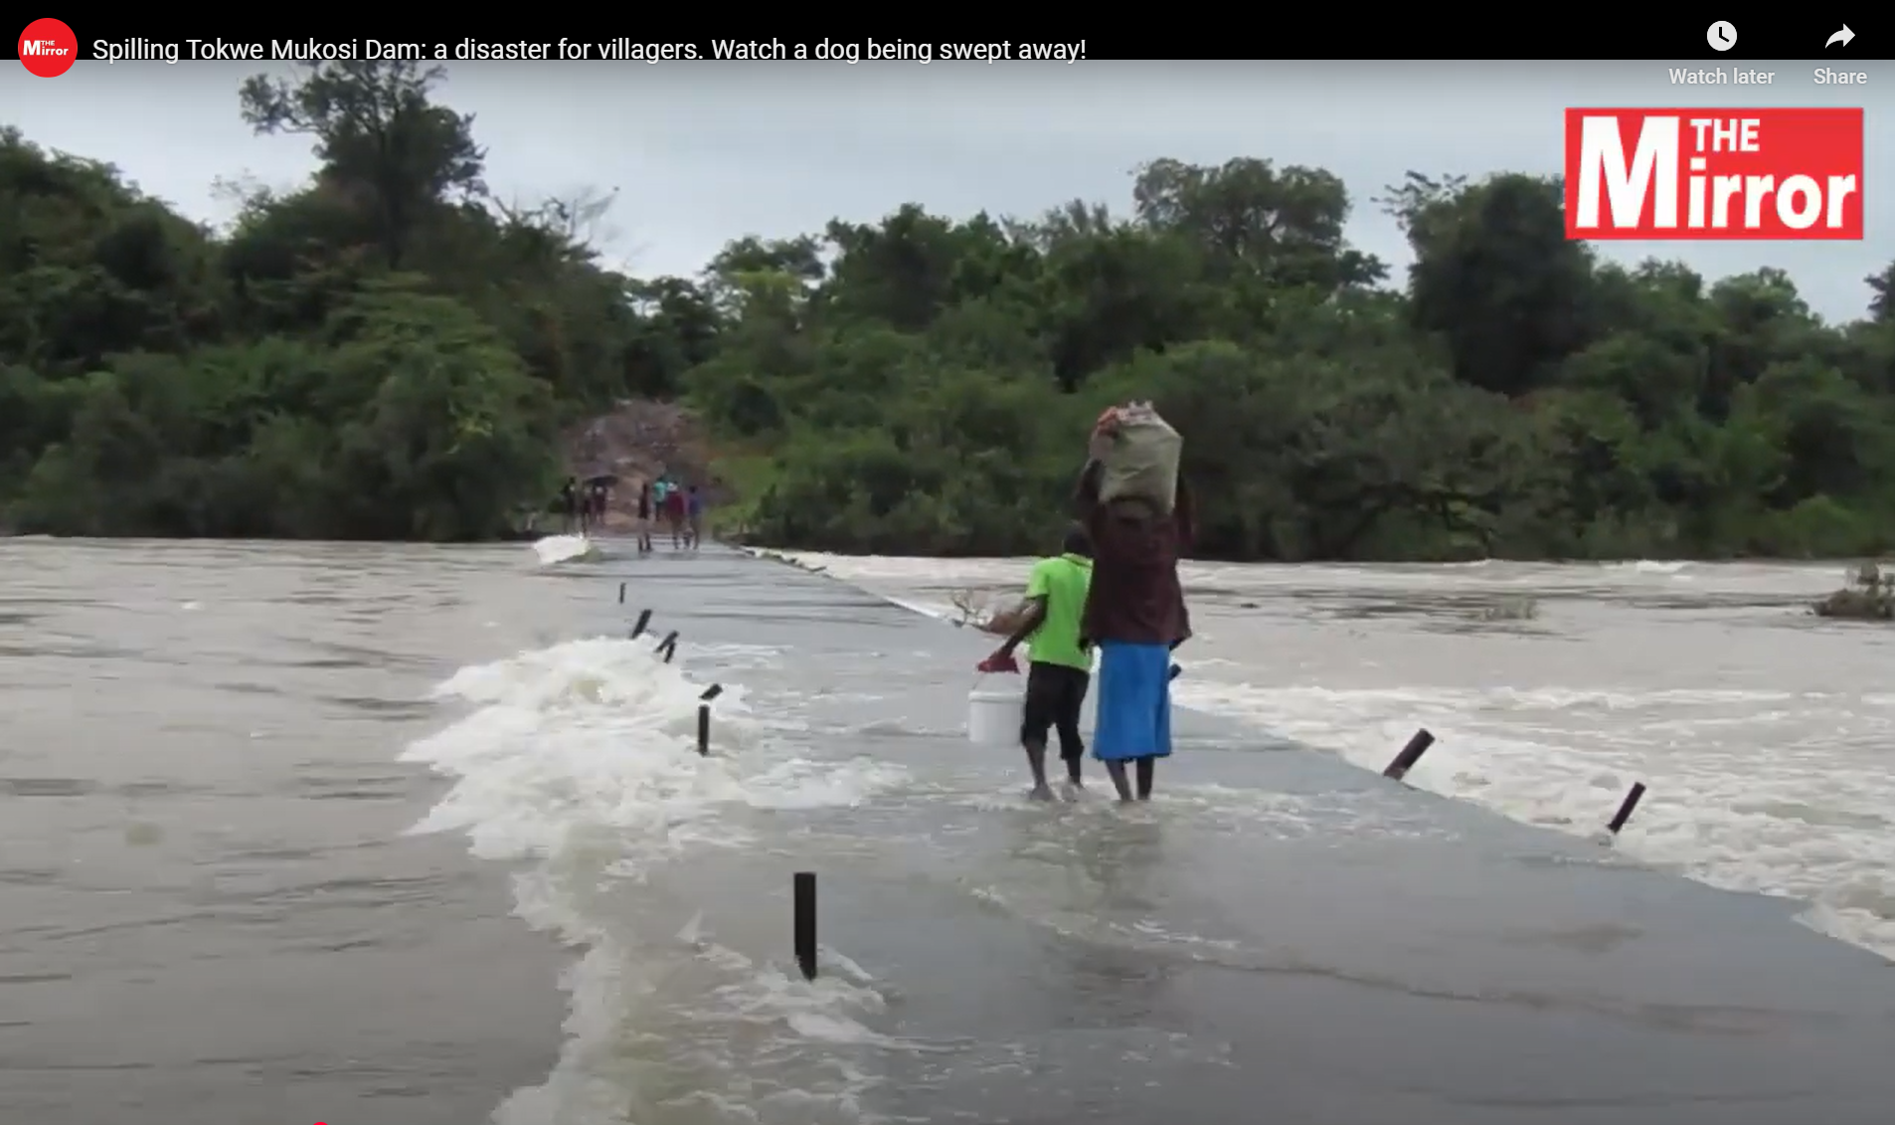
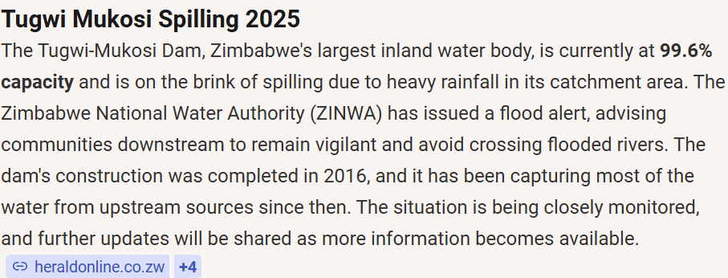
6. Rainfall Distribution: Extreme events rainfall events
Intense rainfall events during January led to flooding and excess water accumulation in several parts of the country, particularly in the south and southeast. The map shows a high number of rainy days and sustained wet conditions, indicating prolonged saturation rather than isolated storms.
These conditions resulted in localized flooding, crop damage, and infrastructure disruption, while also contributing to significant dam recharge, with major reservoirs such as Tugwi Mukosi reaching full capacity.
Fig 5(c) Crops destroyed as a result of continuous heavy January wet spell
c
Fig 5(a) Number of intense rainfall days (P90) in the in the 30‑day ending 31 January 2026.
Fig 5(b) Tugwi Mukosi which is the country’s largest inland water body spilling
as a result of continuous heavy rains 2025/2026 season
https://www.facebook.com/zinwawater/videos/-tugwi-mukosi-dam-full-and-flowingthe-dam-is-at-100-capacity-and-water-is-safely/1376285944545064/
Notes:
Recap the season here, irregularity of the eason, irregular season gdry=wet alternation
colored text. Highlight the impact of drier than usual conditions on agriculture and livestock in most countries.

Slide 8
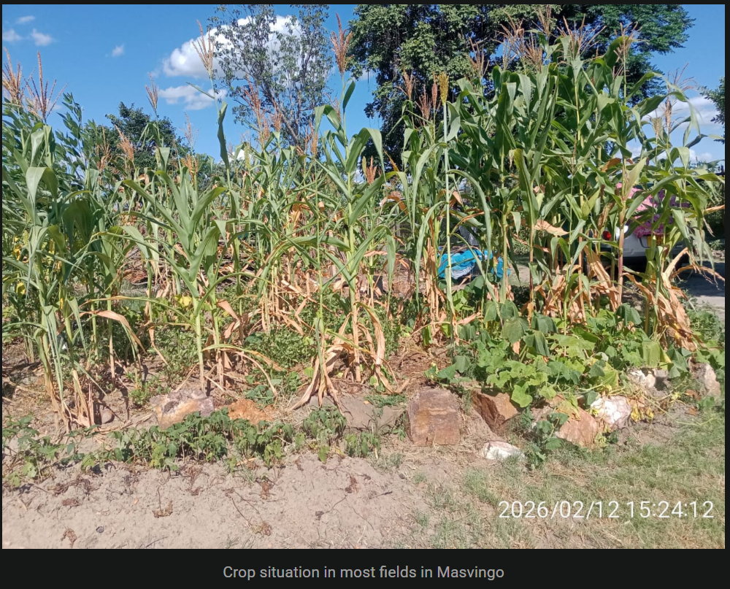
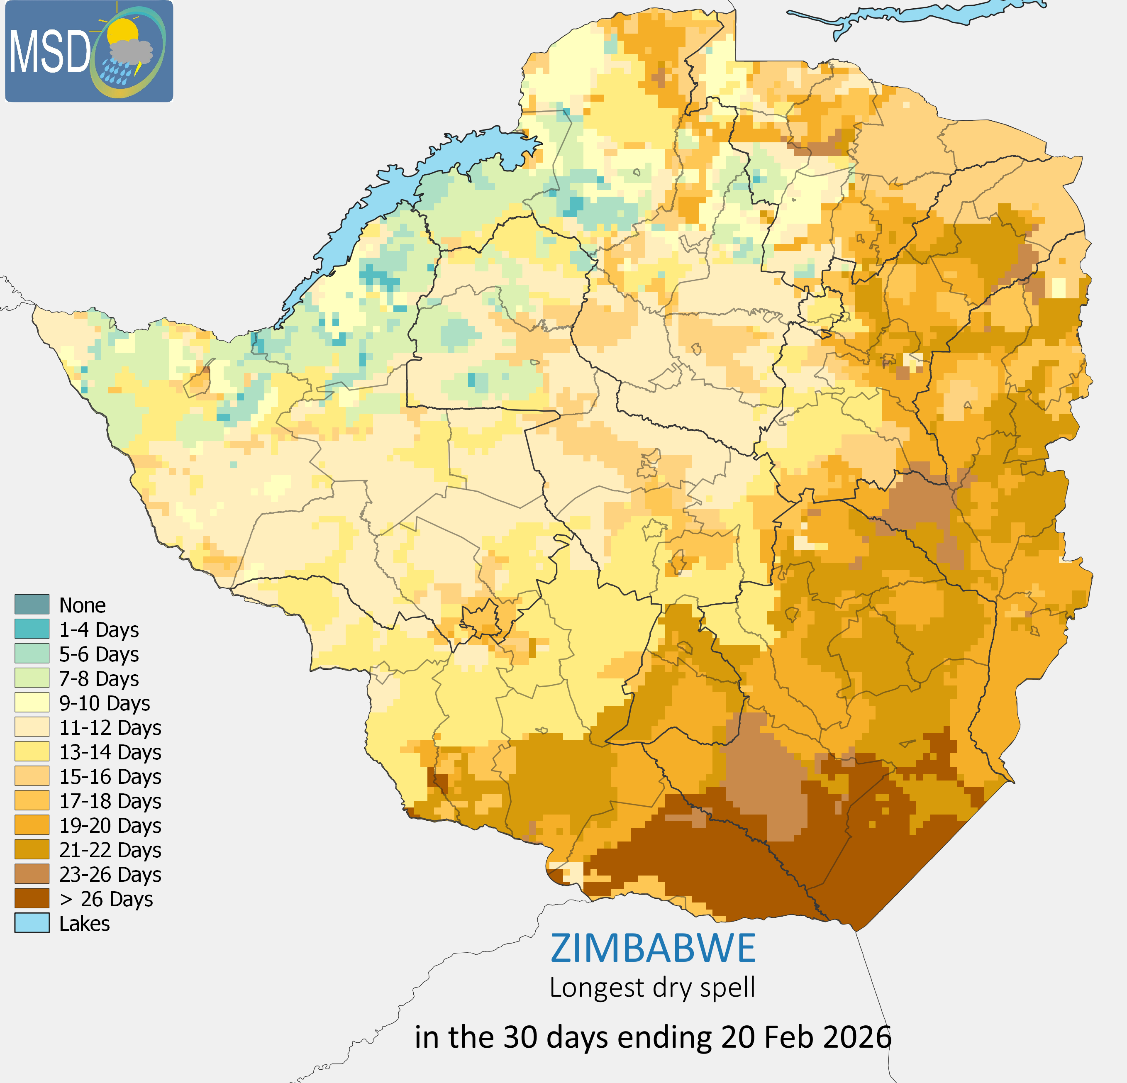
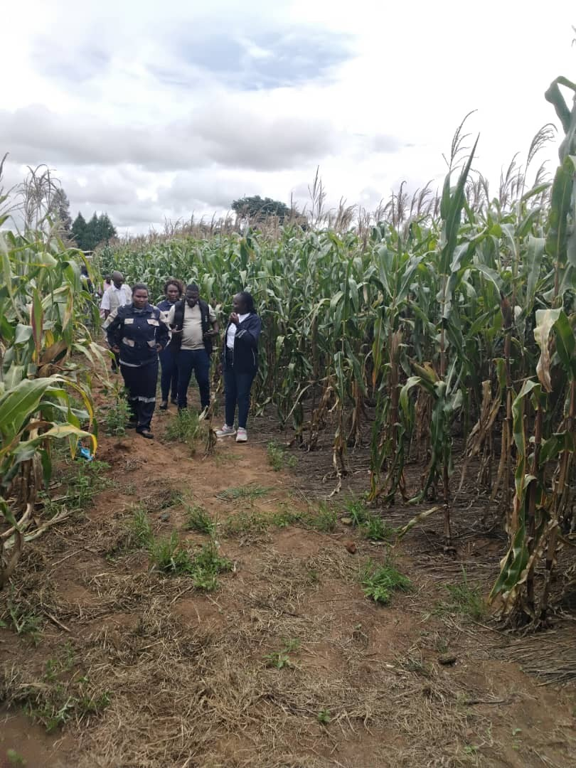
7. Rainfall Distribution: Extreme events rainfall events (Dry spells)
This abrupt transition from excess rainfall to moisture deficit disrupted crop development and led to widespread wilting and reduced yield potential, particularly in rainfed systems. In some areas, the impact of moisture stress during this period may have caused irreversible damage. The contrast between strong water recharge and agricultural stress highlights that rainfall distribution, rather than cumulative seasonal totals, is the primary driver of risk this season.
Fig 6(a) : Crop situation in Masvingo during the dry spell
Following the wet conditions in January, a prolonged dry spell from late January to mid–late February affected much of the country. The map shows extended dry spell durations, particularly across the southern, eastern, and central regions, where dry periods exceeded 15–20 consecutive days.
Fig 6(b) Longest dry spell in the 30‑day ending 20 February 2026.
Fig 6(c) Crop situation in Murehwa Ward 23
Notes:
Recap the season here, irregularity of the eason, irregular season gdry=wet alternation
colored text. Highlight the impact of drier than usual conditions on agriculture and livestock in most countries.

Slide 9
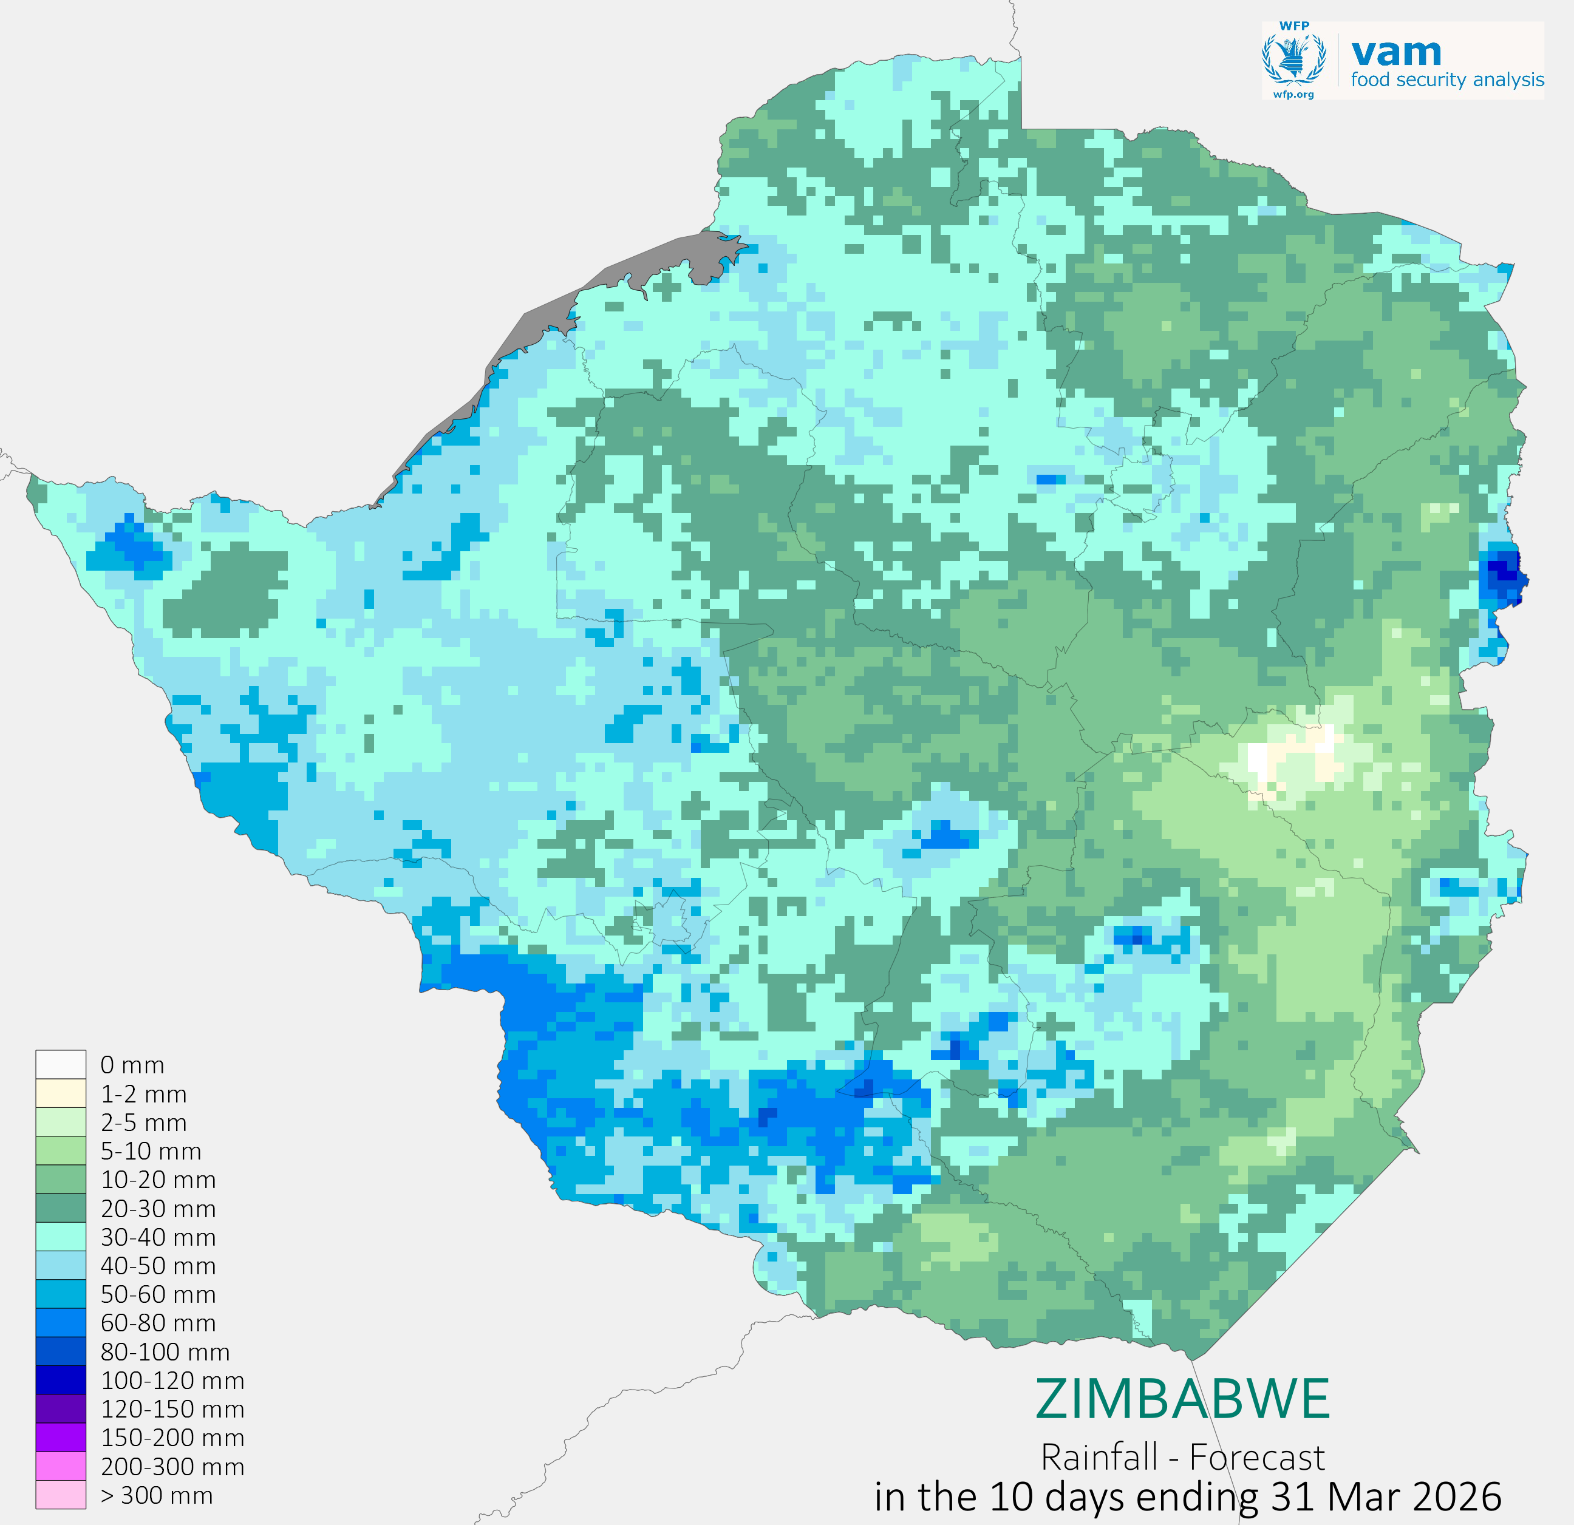
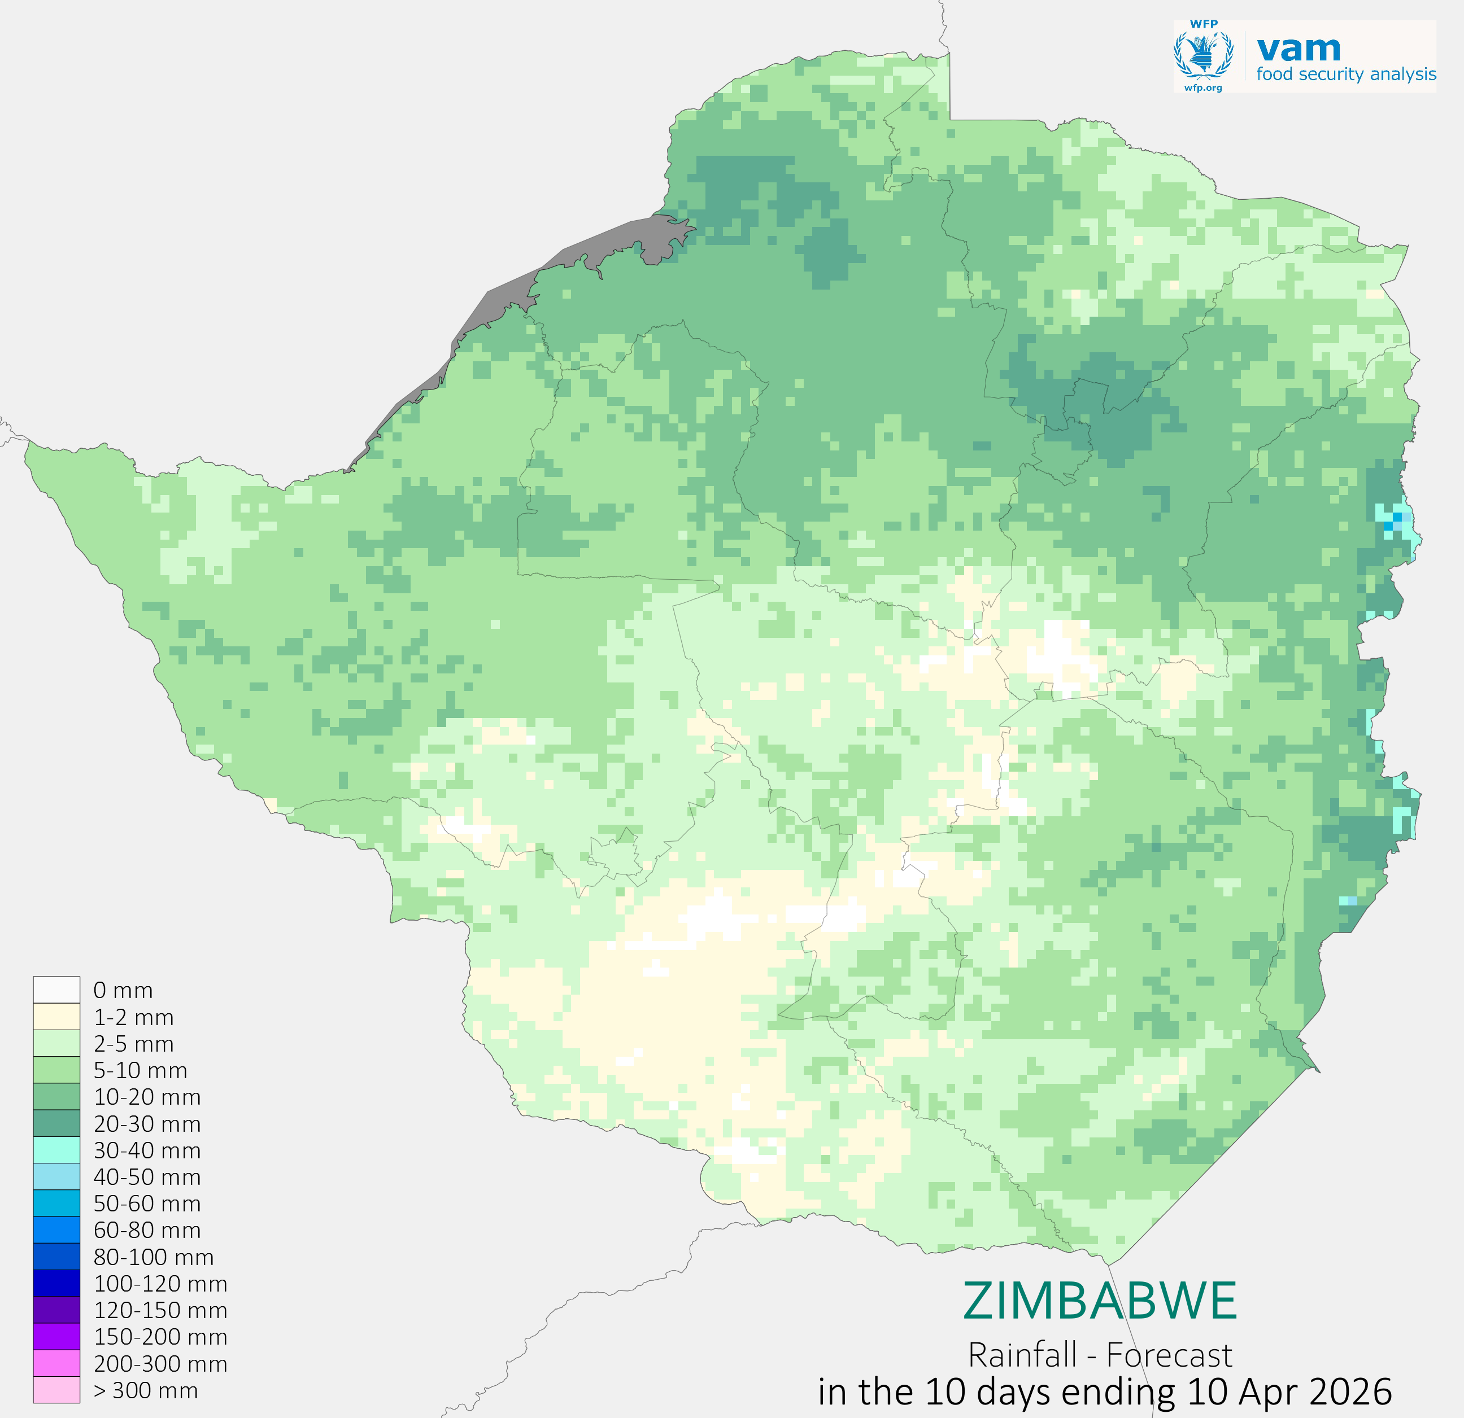
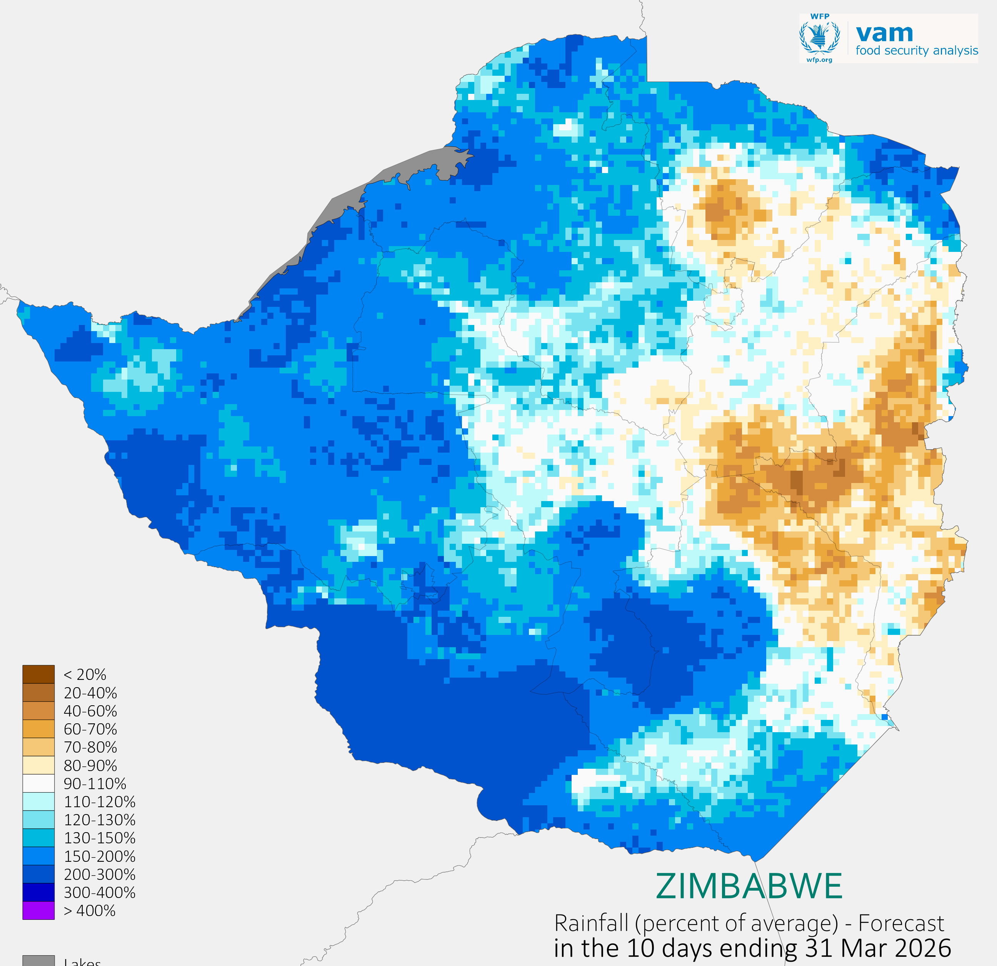
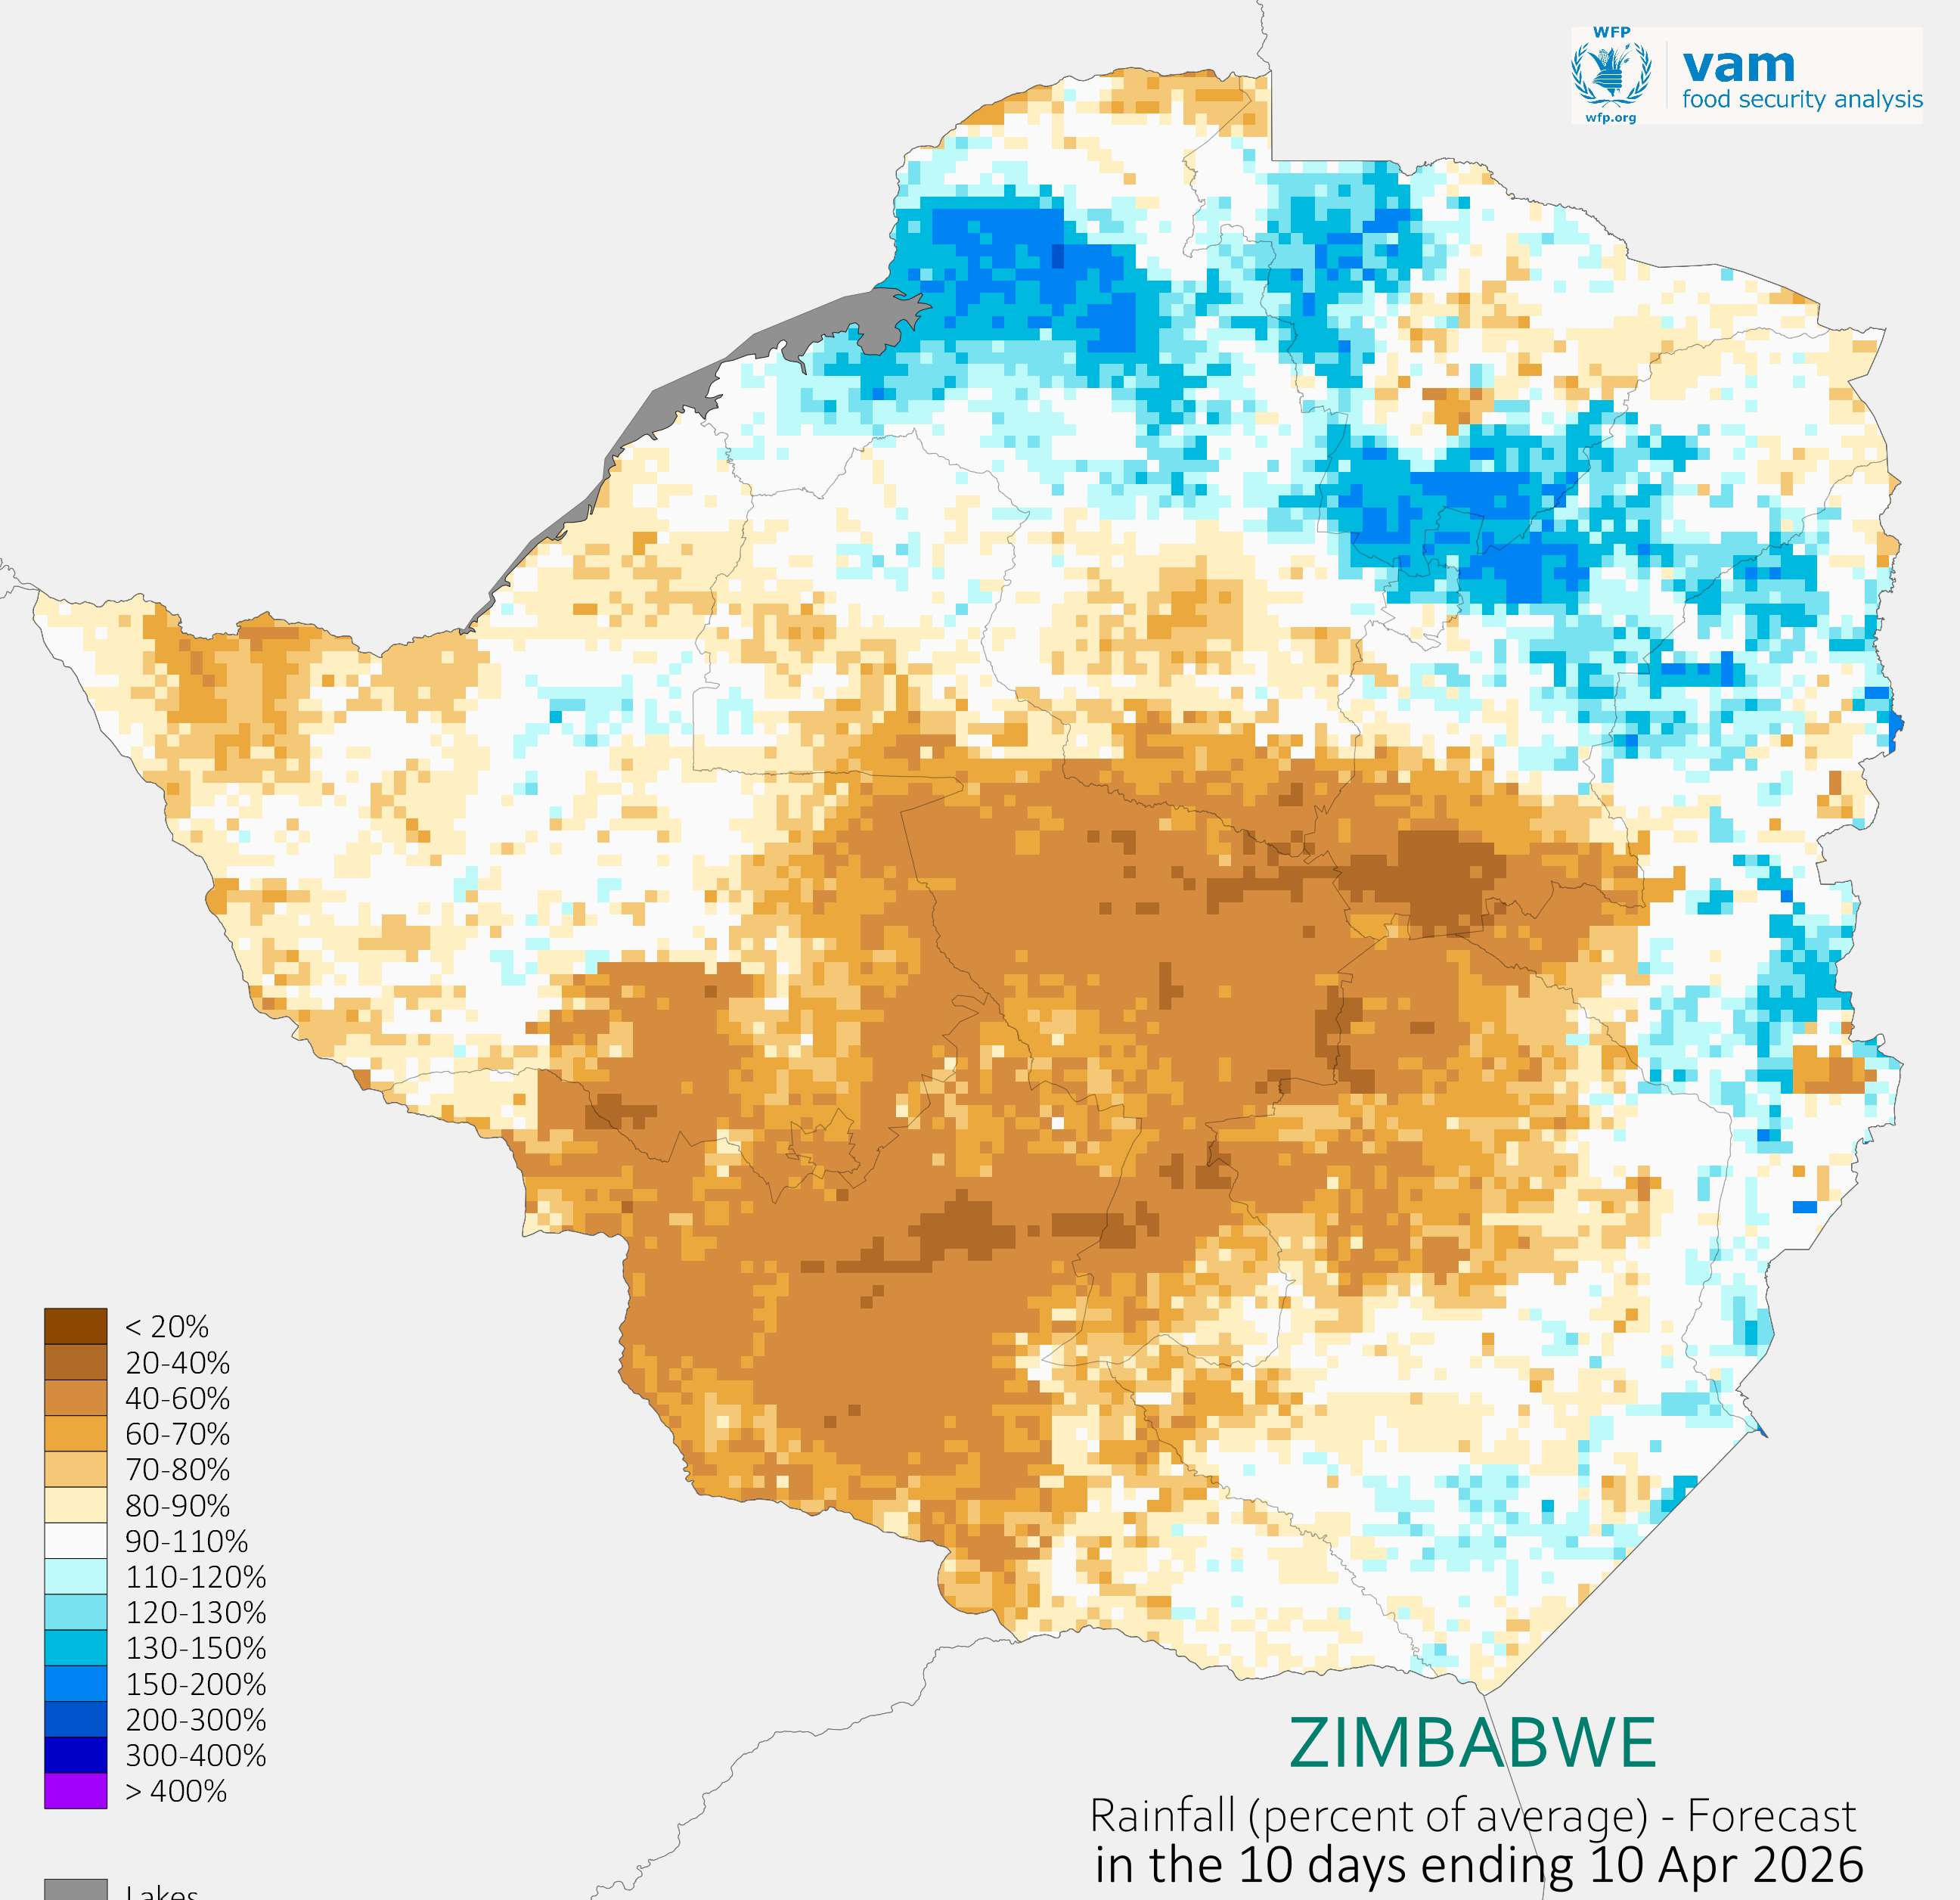
8. Short term Outlook
Rainfall is expected to continue through late March, with generally favourable conditions in western and southern areas, while more variable conditions are expected across central and eastern regions. This may support short-term improvements in soil moisture, particularly in areas that have already received rainfall during March.
However, by early April, there is an indication of drier-than-average conditions developing across central and southern areas, while relatively better conditions may persist in parts of the north-eastern regions. As a result, the outlook suggests a stabilization of current conditions rather than a full recovery, particularly in areas that have remained moisture-deficit.
From an agricultural perspective, the expected rainfall may benefit late-planted crops and pasture conditions, but it is unlikely to fully offset the impacts of earlier moisture stress on crops affected during critical growth stages
Fig 7a) Rainfall forecast amounts in mm, in the 10 days ending 31 Mar 2026 (left) 10 Apr 2026(right)
Fig 7(b).Rainfall forecast in the 10 days ending 31 Mar 2026 (left) 10 Apr 2026(right), as percent of average. Browns = drier than average, blues = wetter than average
Notes:
Recap the season here, irregularity of the eason, irregular season gdry=wet alternation
colored text. Highlight the impact of drier than usual conditions on agriculture and livestock in most countries.

Slide 10
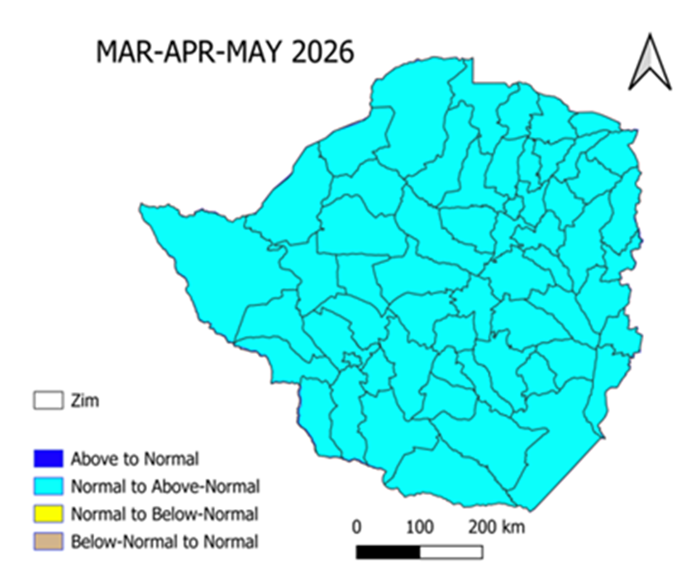
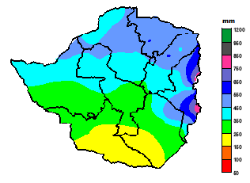
9. Outlook: Long Range
Long Range (January-February-March)
Fig 8(a) Probabilistic Forecast. Fig 8(b) The long-term average rainfall
March-April-May is expected to receive relatively normal to above normal rainfall. Wetter conditions than the long-term average across the country are thus likely.
The expected cumulative rainfall for the three months (January to March) is likely to be more than the long-term rainfall average for the same period. Technically it should fall within the range 100-125 percent of the long-term average, which is the normal to above normal range.
The long-term average is 30 years for each station across the country and that is considered the normal rainfall for that place. Map Fig 8(a) is the probabilistic forecast and Fig 8(b) is the long-term mean.

Slide 11
10.About the Seasonal Monitor
This monthly bulletin is produced by the Zimbabwe Meteorological Services Department.
Focus of the Bulletin: seasonal monitoring and early warning when necessary, highlighting areas of concern.
World Food Program (WFP) assisting in the incorporation of satellite data to observations to address the concern of coverage of the area of interest.

Slide 12


For further information, contact:
Phone: 0242 778160
E-mail: thedirectormsd@gmail.com

